Slide 1
Linear programming and circuit imbalances
László Végh
IPCO Summer School Georgia Tech, May 2021
Slides available at https://personal.lse.ac.uk/veghl/ipco

Slide 2
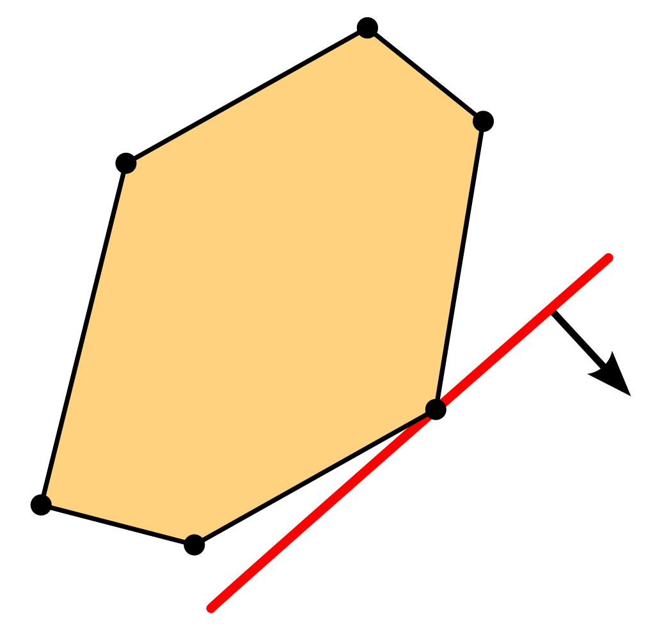
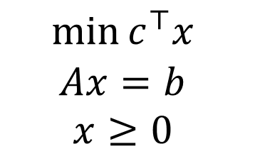
Linear programming
$$\min{c^{⊤}x}$$
$$Ax=b$$
$$x≥0$$
Geometry
Combinatorics
Analysis
LP
Game theory
Operations Research
Integer Prog-ramming
Convex optimization

Slide 3
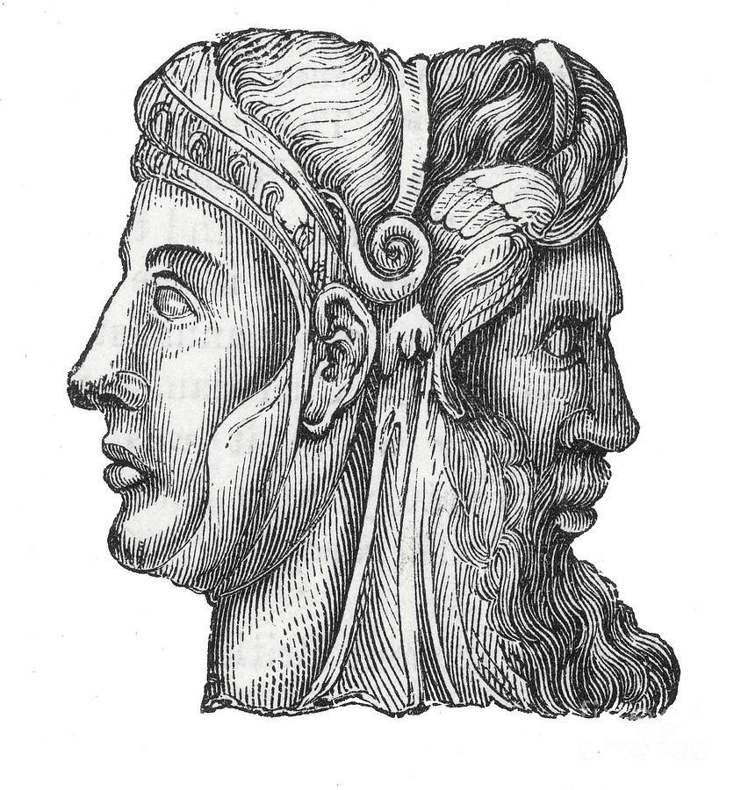
Facets of linear programming
Discrete
Basic solutions
Polyhedral combinatorics
Exact solution
Continuous
Continuous solutions
Convex program
Approximate solution

Slide 4
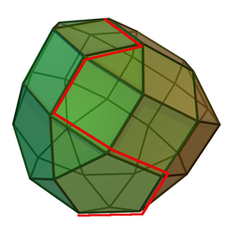
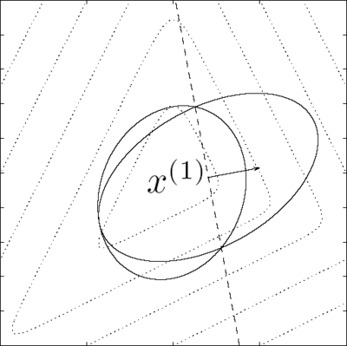
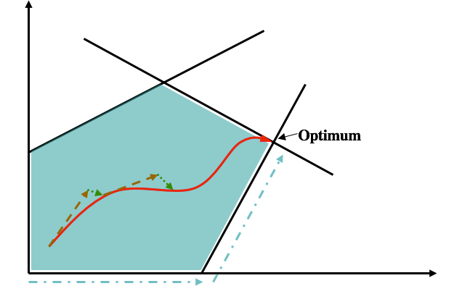
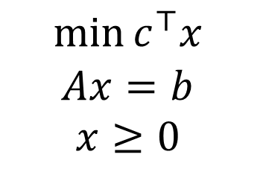
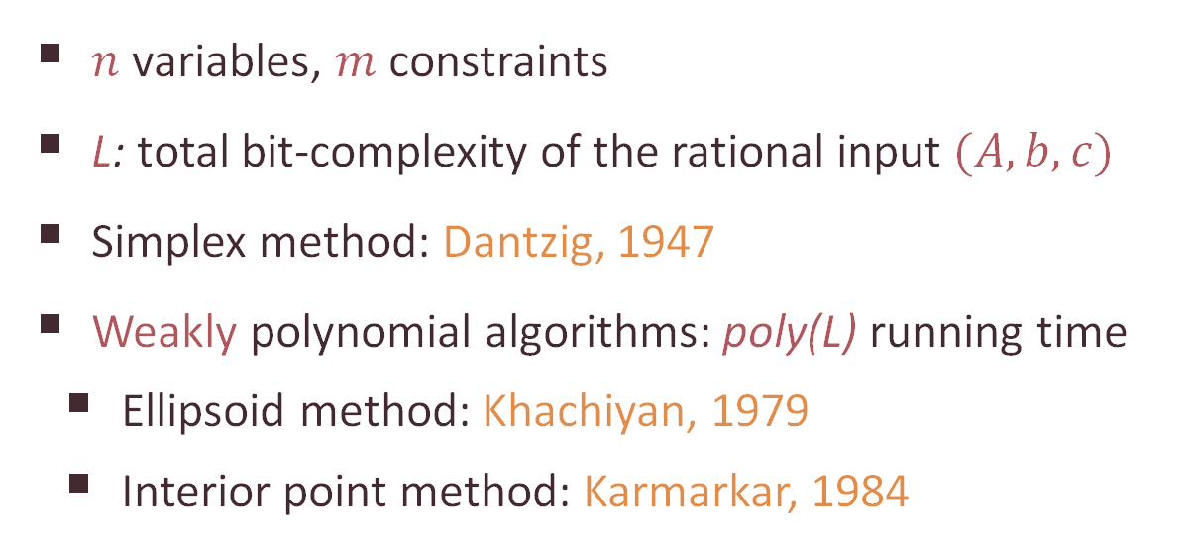
Linear programming algorithms
$$\min{c^{⊤}x}$$
$$Ax=b$$
$$x≥0$$
$n$ variables, $m$constraints
L: total bit-complexity of the rational input $(A,b,c)$
Simplex method: Dantzig, 1947
Weakly polynomial algorithms: poly(L) running time
Ellipsoid method: Khachiyan, 1979
Interior point method: Karmarkar, 1984

Slide 5
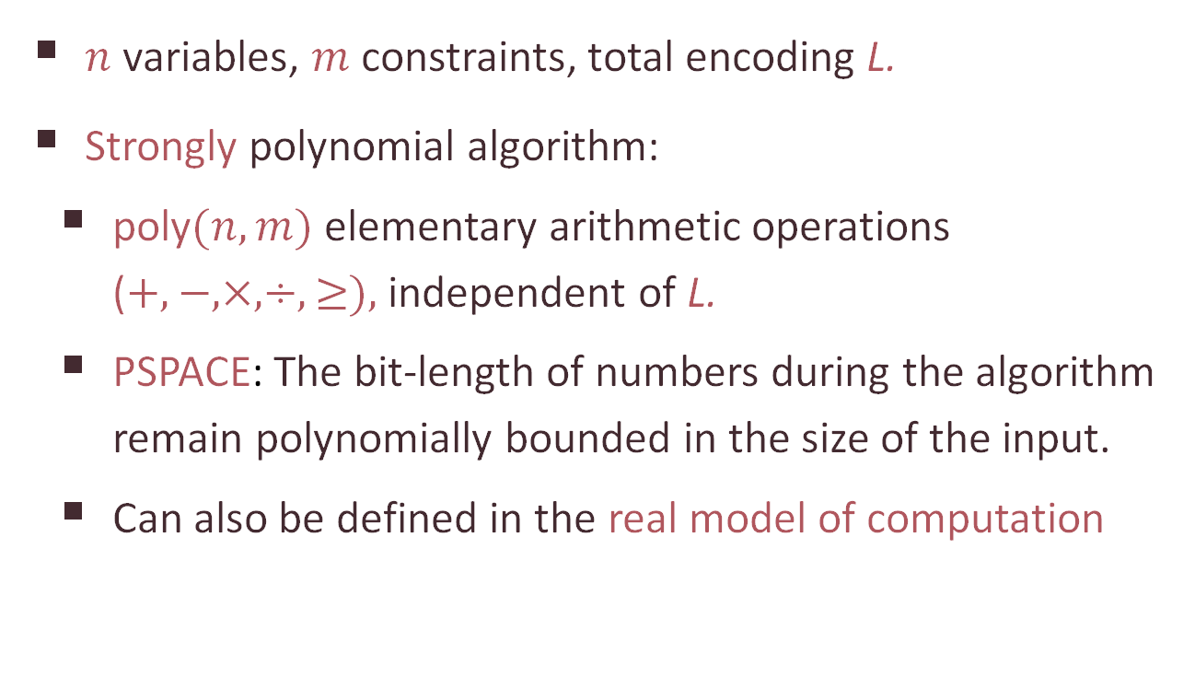
Weakly vs strongly polynomial algorithms for LP
$$\min{c^{⊤}x}$$
$$Ax=b$$
$$x≥0$$
$n$ variables, $m$constraints, total encoding L.
Strongly polynomial algorithm:
poly$(n,m)$ elementary arithmetic operations ($+,−,×,÷,≥),$ independent of L.
PSPACE: The bit-length of numbers during the algorithm remain polynomially bounded in the size of the input.
Can also be defined in the real model of computation

Slide 6
Is there a strongly polynomial algorithm for Linear Programming?
Smale’s 9th question

Slide 7
Strongly polynomial algorithms for some classes of Linear Programs
Systems of linear inequalities with at most two nonzero variables per inequality: Megiddo ’83
Network flow problems
Maximum flow: Edmonds-Karp-Dinitz ’70-72, …
Min-cost flow: Tardos ’85, Fujishige ’86, Goldberg-Tarjan ’89, Orlin ’93, …
Generalized flow: V ’17, Olver-V ’20
Discounted Markov Decision Processes: Ye ’05, Ye ’11, …

Slide 8
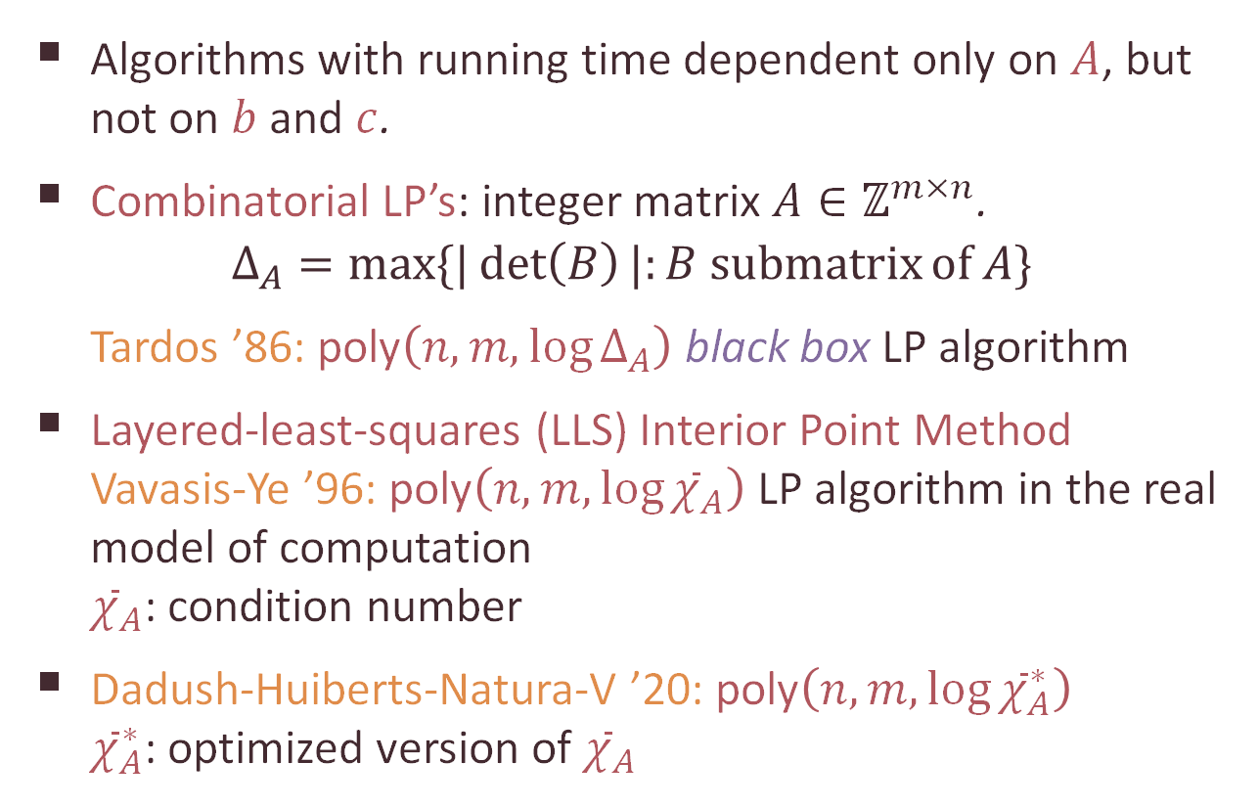
Dependence on the constraint matrix only
$$\min{c^{⊤}x,} Ax=b x≥0$$
Algorithms with running time dependent only on $A$, but not on $b$ and $c$.
Combinatorial LP’s: integer matrix $A∈ℤ^{m×n}$.
$$Δ_{A}=\max{\{|\det\left(B\right)|:B submatrix}of A\}$$
Tardos ’86: poly$\left(n,m,\log{Δ_{A}}\right)$ black box LP algorithm
Layered-least-squares (LLS) Interior Point Method Vavasis-Ye ’96: poly$\left(n,m,\log{{\overline{χ}}_{A}}\right)$ LP algorithm in the real model of computation ${\overline{χ}}_{A}$: condition number
Dadush-Huiberts-Natura-V ’20: poly$\left(n,m,\log{{\overline{χ}}_{A}^{∗}}\right)$ ${\overline{χ}}_{A}^{∗}$: optimized version of ${\overline{χ}}_{A}$

Slide 9
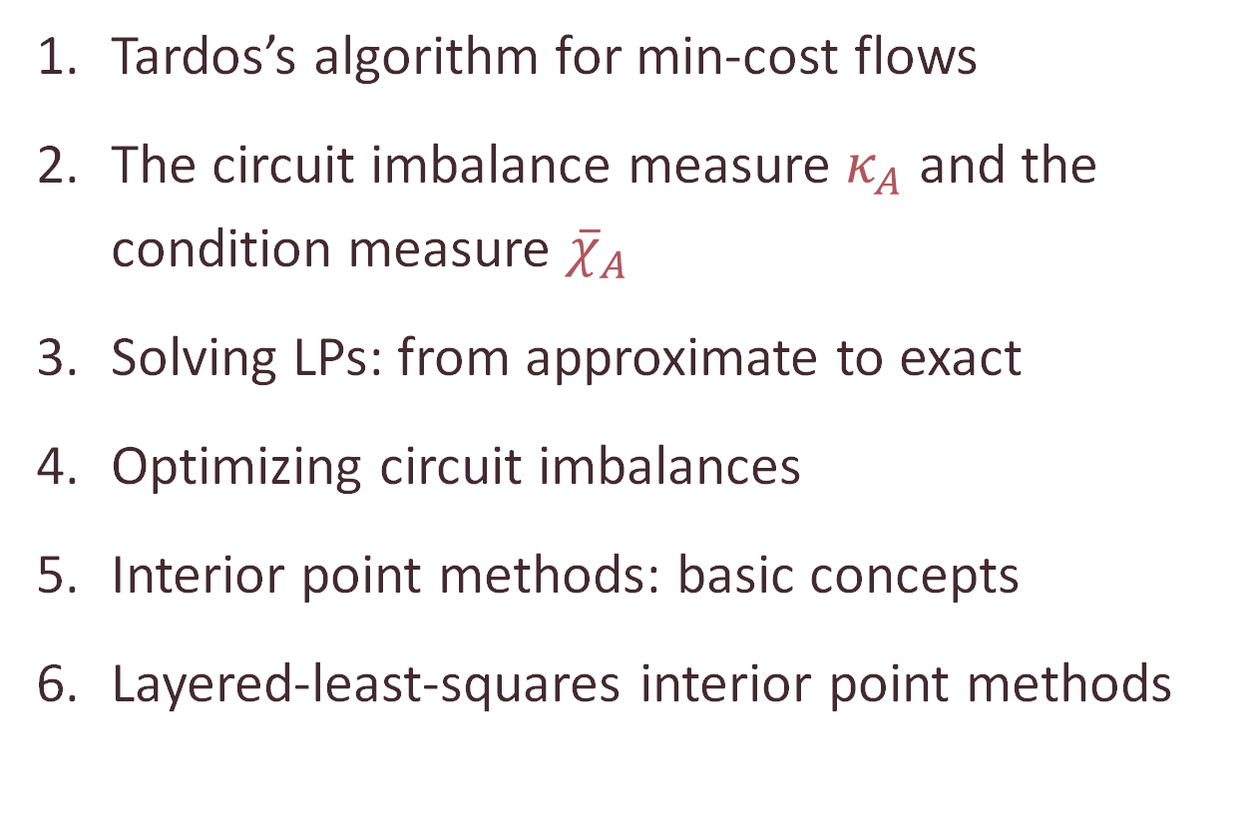
Outline of the lectures
Tardos’s algorithm for min-cost flows
The circuit imbalance measure $κ_{A}$ and the condition measure ${\overline{χ}}_{A}$
Solving LPs: from approximate to exact
Optimizing circuit imbalances
Interior point methods: basic concepts
Layered-least-squares interior point methods

Slide 10



Dadush-Huiberts-Natura-V ’20: A scaling-invariant algorithm for linear programming whose running time depends only on the constraint matrix
Dadush-Natura-V ’20: Revisiting Tardos’s framework for linear programming: Faster exact solutions using approximate solvers

Slide 11
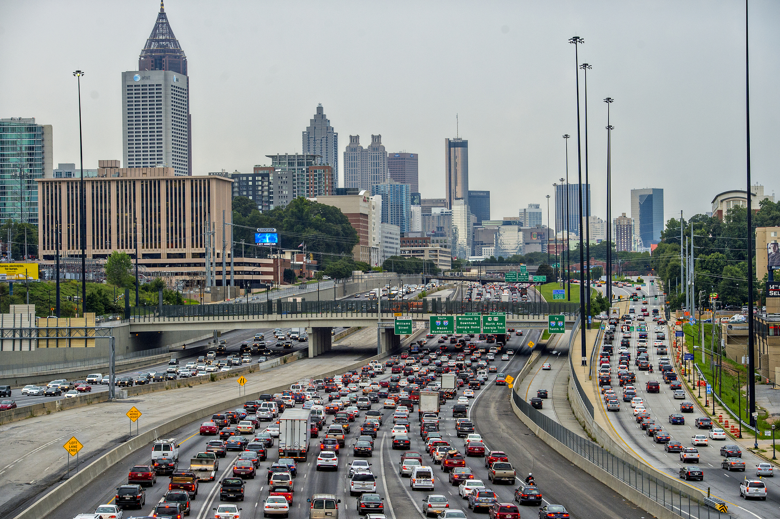
Part 1 Tardos’s algorithm for min-cost flows circuits, proximity, and variable fixing

Slide 12
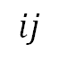


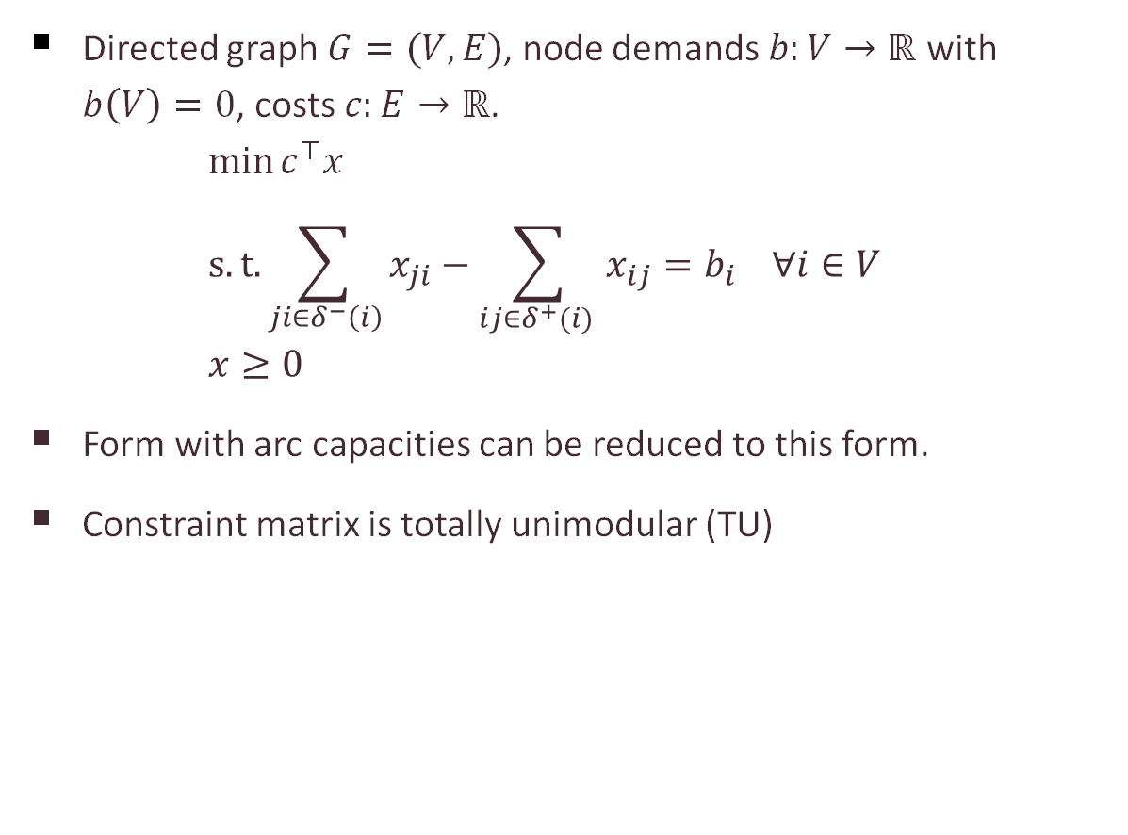
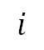
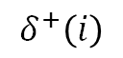
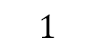
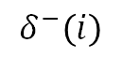
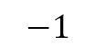
The minimum-cost flow problem
Directed graph $G=(V,E)$, node demands $b:V→ℝ$ with $b\left(V\right)=0$, costs $c:E→ℝ$. $\min{c^{⊤}x}$ $s.t. \sum_{ji∈δ^{−}\left(i\right)}{x_{ji}}−\sum_{ij∈δ^{+}(i) }{x_{ij}}=b_{i} ∀i∈V$ $x≥0$
Form with arc capacities can be reduced to this form.
Constraint matrix is totally unimodular (TU)
$$δ^{+}\left(i\right)$$
$$δ^{−}\left(i\right)$$
$$i$$
arcs
$$ij$$
$$i$$
$$−1$$
nodes
$$j$$
$$1$$

Slide 13
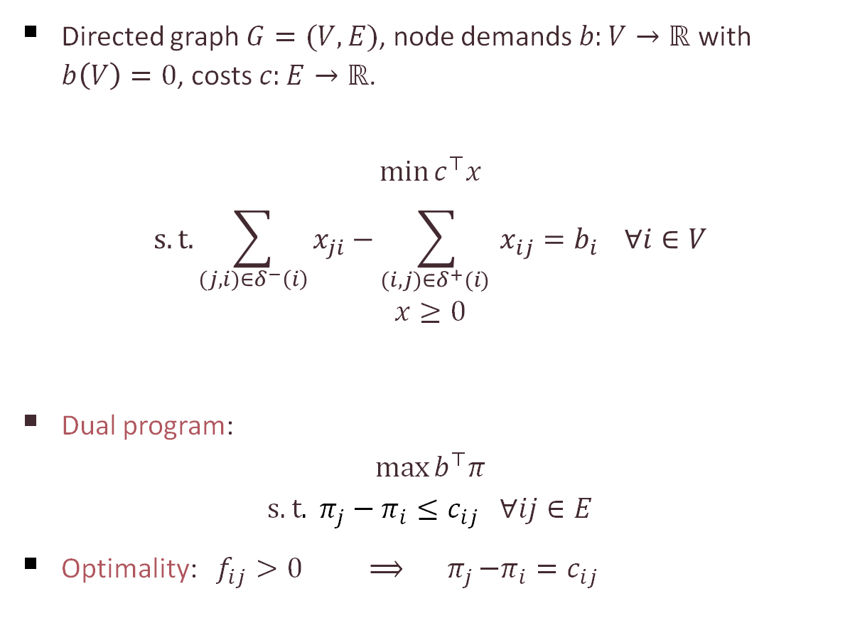
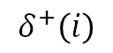
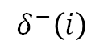
The minimum-cost flow problem: optimality
Directed graph $G=(V,E)$, node demands $b:V→ℝ$ with $b\left(V\right)=0$, costs $c:E→ℝ$.
$$\min{c^{⊤}x} \\ s.t. \sum_{(j,i)∈δ^{−}\left(i\right)}{x_{ji}}−\sum_{(i,j)∈δ^{+}(i) }{x_{ij}}=b_{i} ∀i∈V \\ x≥0$$
Dual program:
$$\max{b^{⊤}π} \\ s.t. π_{j}−π_{i}≤c_{ij} ∀ij∈E$$
Optimality: $f_{ij}>0 ⟹{ π}_{j}−π_{i}=c_{ij}$
$$δ^{+}\left(i\right)$$
$$δ^{−}\left(i\right)$$
$$i$$

Slide 14
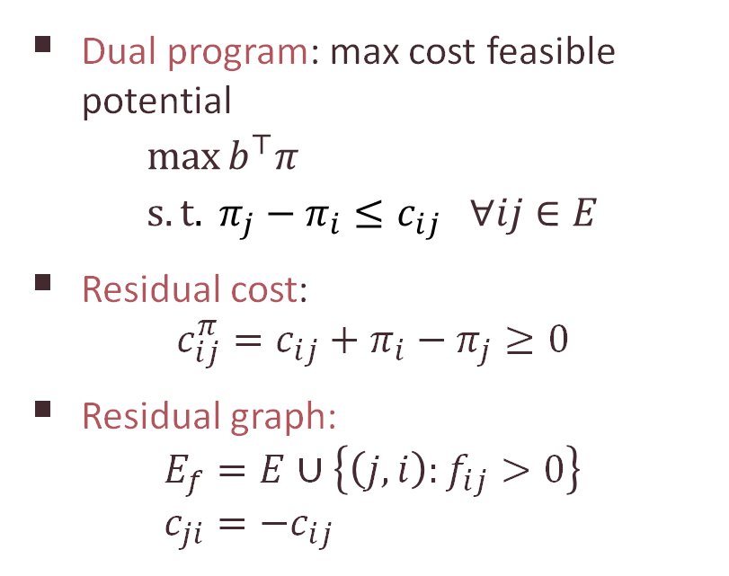
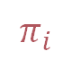
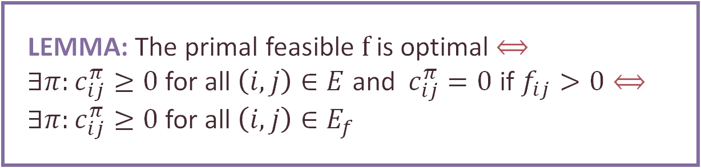
Dual solutions: potentials
$$π_{i}$$
Dual program: max cost feasible potential
$$\max{b^{⊤}π} \\ s.t. π_{j}−π_{i}≤c_{ij} ∀ij∈E$$
Residual cost: $c_{ij}^{π}=c_{ij}+π_{i}−π_{j}≥0$
Residual graph: $E_{f}=E∪\left\{\left(j,i\right):f_{ij}>0\right\}$ $c_{ji}=−c_{ij}$
-1
1
-3
3
LEMMA: The primal feasible $f$ is optimal $⟺$ $∃π:c_{ij}^{π}≥0$for all $\left(i,j\right)∈E$ and $c_{ij}^{π}=0$ if $f_{ij}>0⟺$
$∃π:c_{ij}^{π}≥0$for all $\left(i,j\right)∈E_{f}$

Slide 15
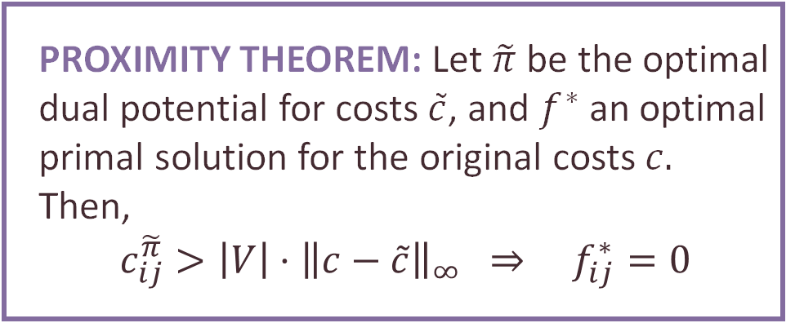
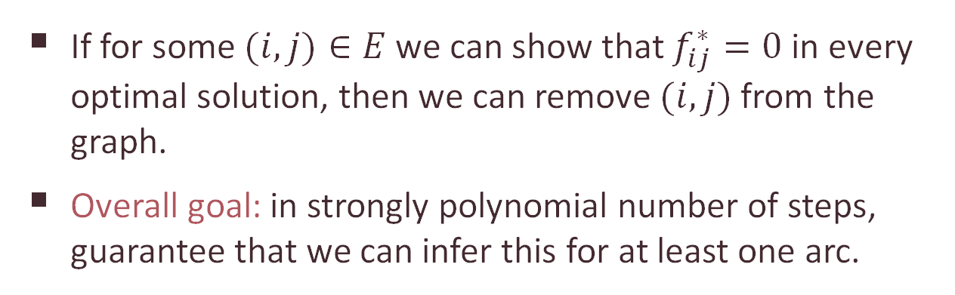
Variable fixing by proximity
If for some $(i,j)∈E$ we can show that $f_{ij}^{∗}=0$ in every optimal solution, then we can remove $(i,j)$ from the graph.
Overall goal: in strongly polynomial number of steps, guarantee that we can infer this for at least one arc.
PROXIMITY THEOREM: Let $\tilde{π}$ be the optimal dual potential for costs $\tilde{c}$, and $f^{∗}$ an optimal primal solution for the original costs $c.$ Then, $$c_{ij}^{\tilde{π}}>\left|V\right|⋅{\left\|c−\tilde{c}\right\|}_{∞} ⇒ f_{ij}^{∗}=0$$

Slide 16
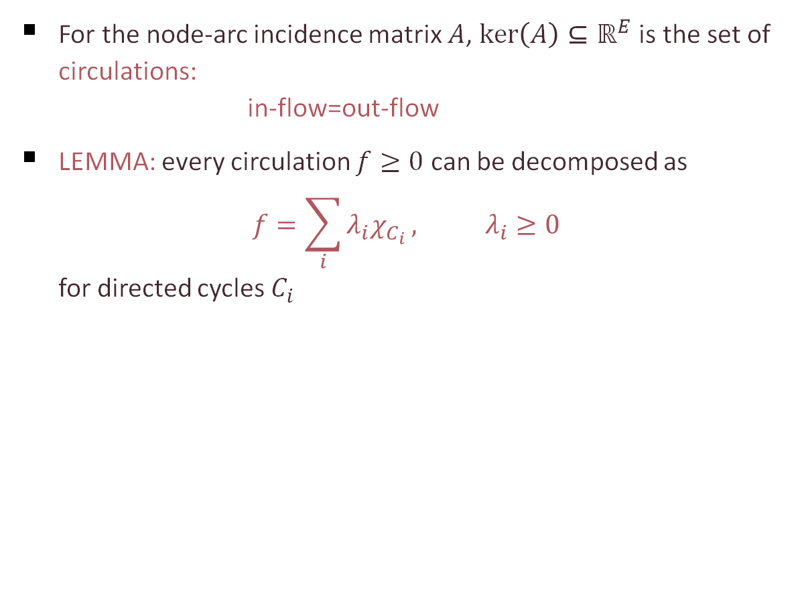
Circulations and cycle decompositions
For the node-arc incidence matrix $A$, $\ker\left(A\right)⊆ℝ^{E}$ is the set of circulations: in-flow=out-flow
LEMMA: every circulation $f≥0$ can be decomposed as $f=\sum_{i}{λ_{i}χ_{C_{i}}}, λ_{i}≥0$ for directed cycles $C_{i}$
2
2+3
3
2+3
2+1
1
1

Slide 17
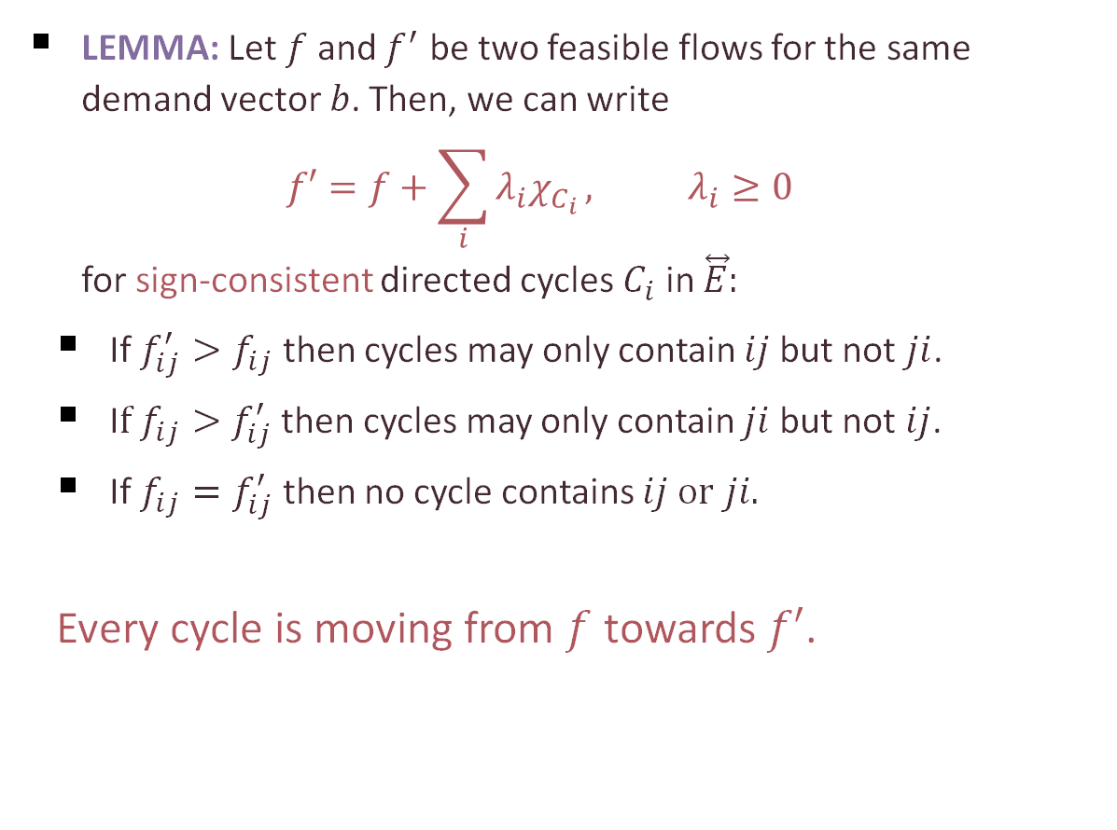
Circulations and cycle decompositions
LEMMA: Let $f$ and $f^{′}$ be two feasible flows for the same demand vector $b$. Then, we can write $f′=f+\sum_{i}{λ_{i}χ_{C_{i}}}, λ_{i}≥0$ for sign-consistent directed cycles $C_{i}$ in $\overset{⃡}{E}:$
If $f_{ij}^{′}>f_{ij}$ then cycles may only contain $ij$but not $ji$.
I$f f_{ij}>f_{ij}^{′}$ then cycles may only contain $ji$but not $ij$.
If $f_{ij}=f_{ij}^{′}$ then no cycle contains $ij or$ $ji.$
Every cycle is moving from $f$ towards $f′$.

Slide 18
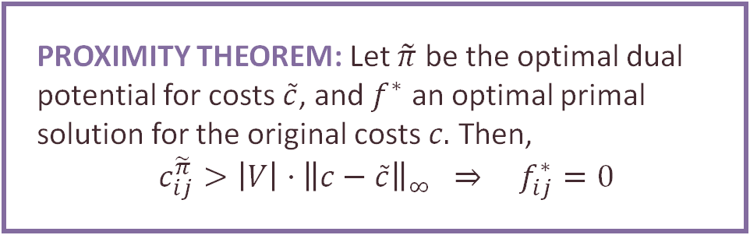
PROXIMITY THEOREM: Let $\tilde{π}$ be the optimal dual potential for costs $\tilde{c}$, and $f^{∗}$ an optimal primal solution for the original costs $c.$ Then, $$c_{ij}^{\tilde{π}}>\left|V\right|⋅{\left\|c−\tilde{c}\right\|}_{∞} ⇒ f_{ij}^{∗}=0$$
PROOF:

Slide 19
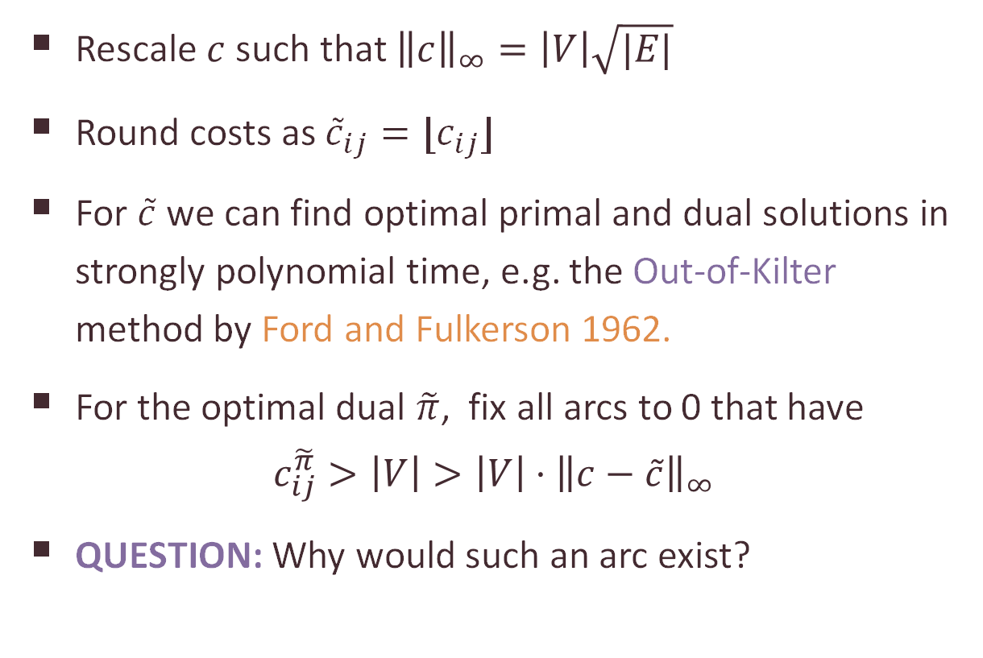
Rounding the costs
Rescale $c$ such that ${\left\|c\right\|}_{∞}=\left|V\right|\sqrt{|E|}$
Round costs as ${\tilde{c}}_{ij}=⌊c_{ij}⌋$
For $\tilde{c}$ we can find optimal primal and dual solutions in strongly polynomial time, e.g. the Out-of-Kilter method by Ford and Fulkerson 1962.
For the optimal dual $\tilde{π}$, fix all arcs to 0 that have $c_{ij}^{\tilde{π}}>\left|V\right|>\left|V\right|⋅{\left\|c−\tilde{c}\right\|}_{∞}$
QUESTION: Why would such an arc exist?

Slide 20
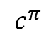
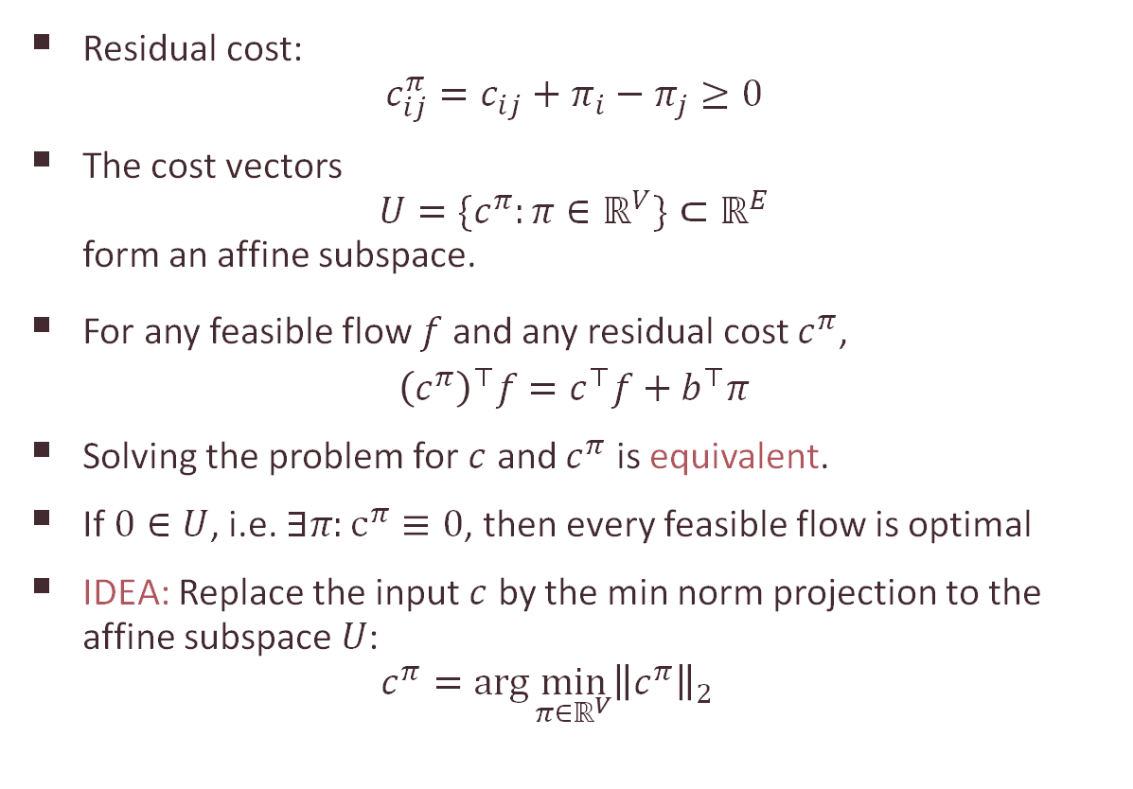
Minimum-norm projections
Residual cost: $c_{ij}^{π}=c_{ij}+π_{i}−π_{j}≥0$
The cost vectors $U=\{c^{π}:π∈ℝ^{V}\}⊂ℝ^{E}$ form an affine subspace.
For any feasible flow $f$ and any residual cost $c^{π}$, ${\left(c^{π}\right)}^{⊤}f=c^{⊤}f+b^{⊤}π$
Solving the problem for $c$ and $c^{π}$ is equivalent.
If $0∈U$, i.e. $∃π:c^{π}≡0$, then every feasible flow is optimal
IDEA: Replace the input $c$ by the min norm projection to the affine subspace $U$: $c^{π}=\arg{\min_{π∈ℝ^{V}}{{\left\|c^{π}\right\|}_{2}}}$
$$c^{π}$$

Slide 21
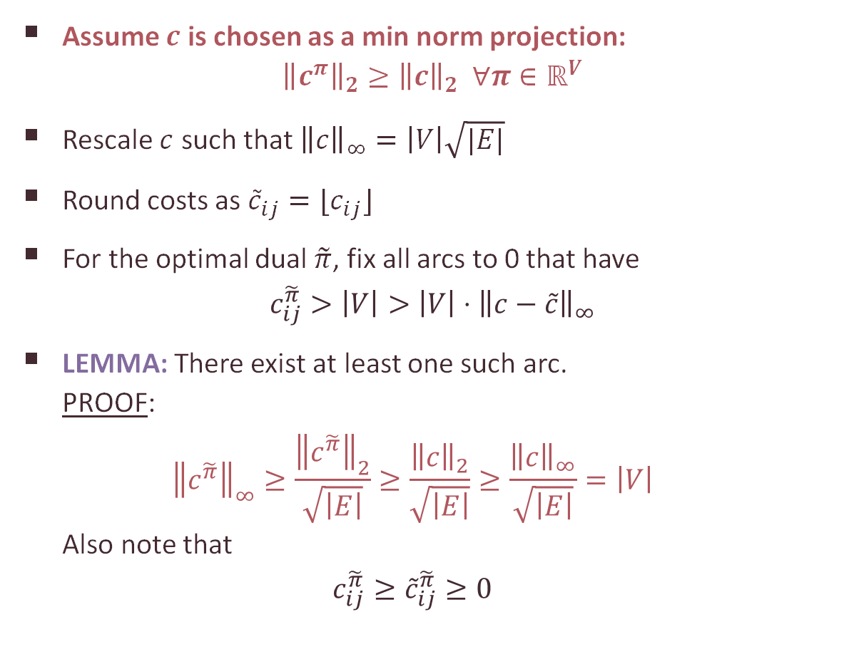
Rounding the costs
Assume $c$ is chosen as a min norm projection: ${\left\|c^{π}\right\|}_{2}≥{\left\|c\right\|}_{2} ∀π∈ℝ^{V}$
Rescale $c$ such that ${\left\|c\right\|}_{∞}=\left|V\right|\sqrt{|E|}$
Round costs as ${\tilde{c}}_{ij}=⌊c_{ij}⌋$
For the optimal dual $\tilde{π}$, fix all arcs to 0 that have $c_{ij}^{\tilde{π}}>\left|V\right|>\left|V\right|⋅{\left\|c−\tilde{c}\right\|}_{∞}$
LEMMA: There exist at least one such arc. PROOF: ${\left\|c^{\tilde{π}}\right\|}_{∞}≥\frac{{\left\|c^{\tilde{π}}\right\|}_{2}}{\sqrt{\left|E\right|}}≥\frac{{\left\|c\right\|}_{2}}{\sqrt{\left|E\right|}}≥\frac{{\left\|c\right\|}_{∞}}{\sqrt{\left|E\right|}}=\left|V\right|$ Also note that $c_{ij}^{\tilde{π}}≥{\tilde{c}}_{ij}^{\tilde{π}}≥0$

Slide 22
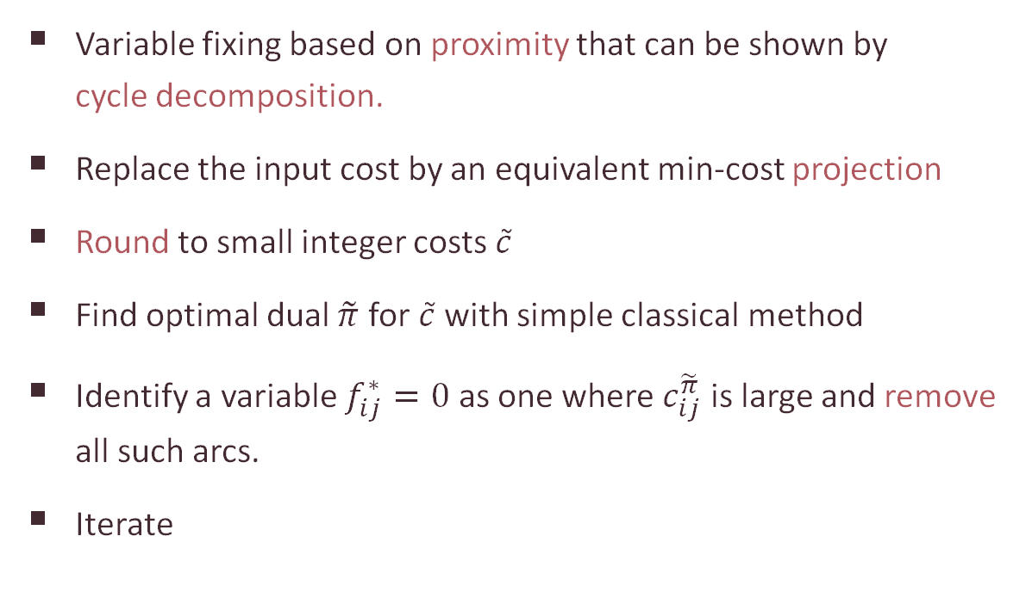
Summary of Tardos’s algorithm
Variable fixing based on proximity that can be shown by cycle decomposition.
Replace the input cost by an equivalent min-cost projection
Round to small integer costs $\tilde{c}$
Find optimal dual $\tilde{π}$ for $\tilde{c}$with simple classical method
Identify a variable $f_{ij}^{∗}=0$ as one where $c_{ij}^{\tilde{π}}$ is large and remove all such arcs.
Iterate

Slide 23
Outline of the lectures
Tardos’s algorithm for min-cost flows
The circuit imbalance measure $κ_{A}$ and the condition measure ${\overline{χ}}_{A}$
Solving LPs: from approximate to exact
Optimizing circuit imbalances
Interior point methods: basic concepts
Layered-least-squares interior point methods

Slide 24


Part 2 The circuit imbalance measure $κ_{A}$ and the condition measure ${\overline{χ}}_{A}$

Slide 25
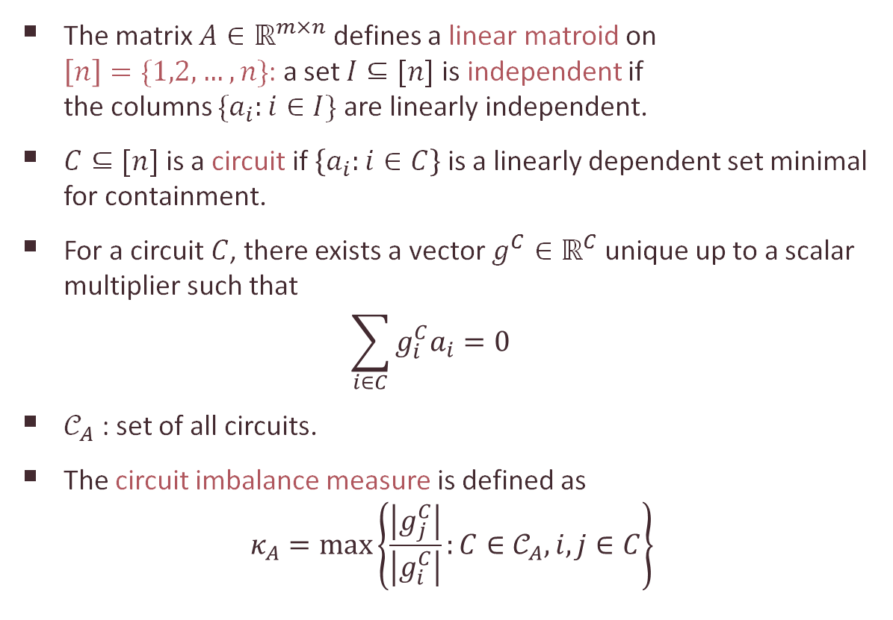
The circuit imbalance measure
The matrix $A∈ℝ^{m×n}$ defines a linear matroid on $\left[n\right]=\{1,2,…,n\}$: a set $I⊆[n]$ is independent if the columns $\{a_{i}:i∈I\}$ are linearly independent.
$C⊆[n]$ is a circuit if $\left\{a_{i}:i∈C\right\}$ is a linearly dependent set minimal for containment.
For a circuit $C$, there exists a vector $g^{C}∈ℝ^{C}$ unique up to a scalar multiplier such that $\sum_{i∈C}{g_{i}^{C}a_{i}=0}$
$𝒞_{A}$ : set of all circuits.
The circuit imbalance measure is defined as $κ_{A}=\max\left\{\frac{\left|g_{j}^{C}\right|}{\left|g_{i}^{C}\right|}:C∈𝒞_{A}, i,j∈C\right\}$
5
2.4
-3
-1

Slide 26
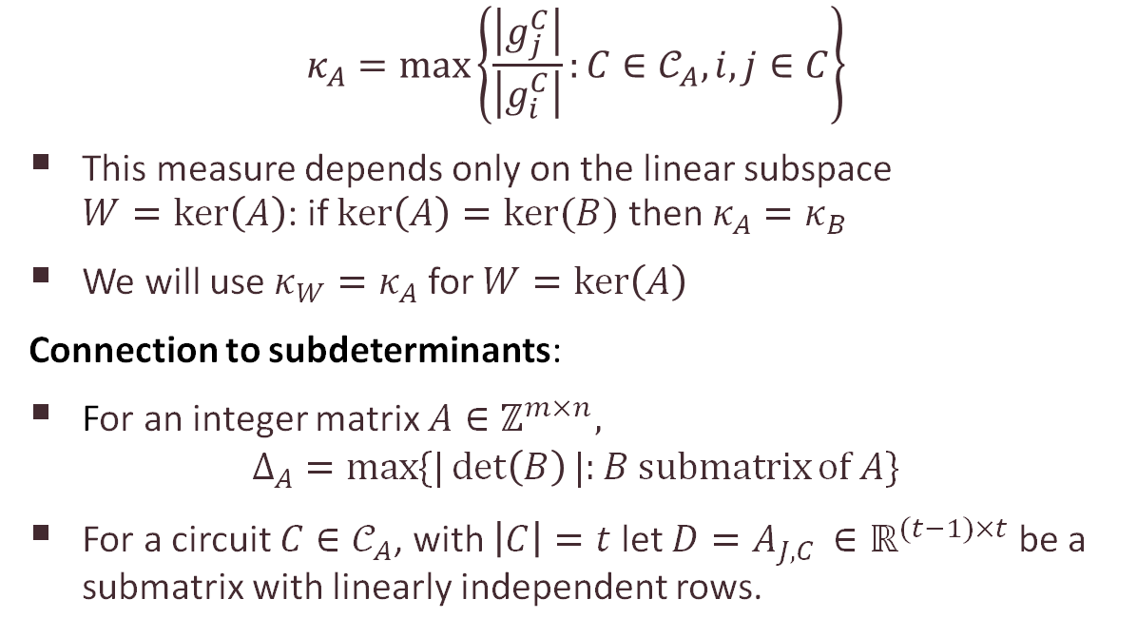
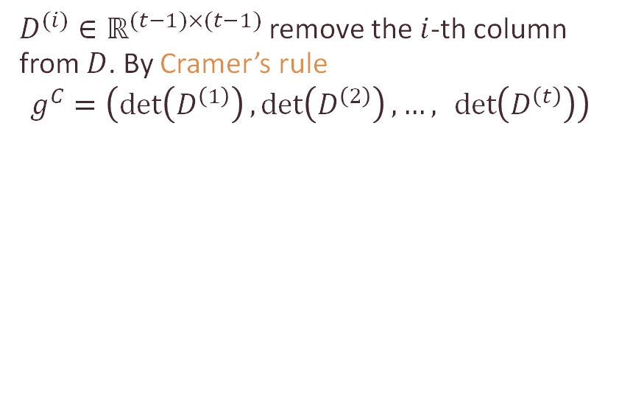

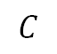


Properties of $κ_{A}$
$$κ_{A}=\max\left\{\frac{\left|g_{j}^{C}\right|}{\left|g_{i}^{C}\right|}:C∈𝒞_{A}, i,j∈C\right\}$$
This measure depends only on the linear subspace $W=\ker\left(A\right)$: if $\ker\left(A\right)=ker⁡(B)$ then $κ_{A}=κ_{B}$
We will use $κ_{W}=κ_{A}$ for $W=\ker\left(A\right)$
Connection to subdeterminants:
For an integer matrix $A∈ℤ^{m×n},$
$$Δ_{A}=\max{\{|\det\left(B\right)|:B submatrix}of A\}$$
For a circuit $C∈𝒞_{A}$, with $\left|C\right|=t$ let $D=A_{J,C }∈ℝ^{(t−1)×t}$ be a submatrix with linearly independent rows.
$$C$$
$D^{(i)}∈ℝ^{(t−1)×(t−1)}$ remove the $i$-th column from $D$. By Cramer’s rule
$$g^{C}=\left(\det\left(D^{\left(1\right)}\right),\det\left(D^{\left(2\right)}\right),…, \det\left(D^{\left(t\right)}\right)\right)$$
$$D$$
$$A$$

Slide 27
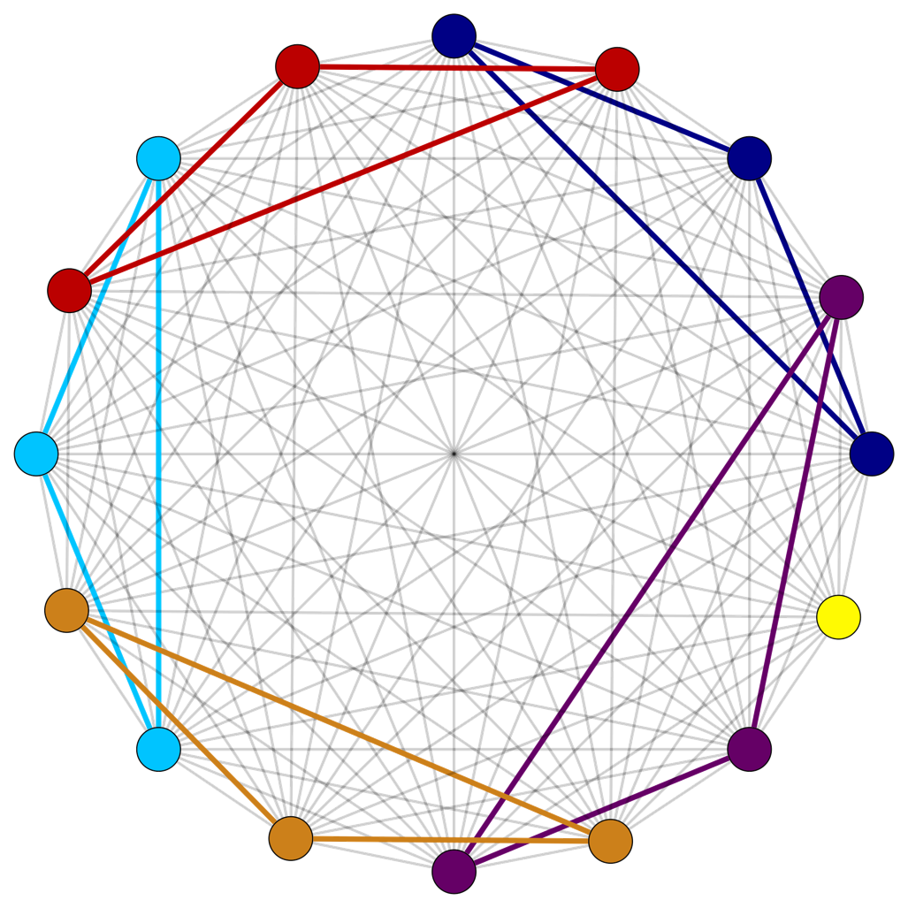
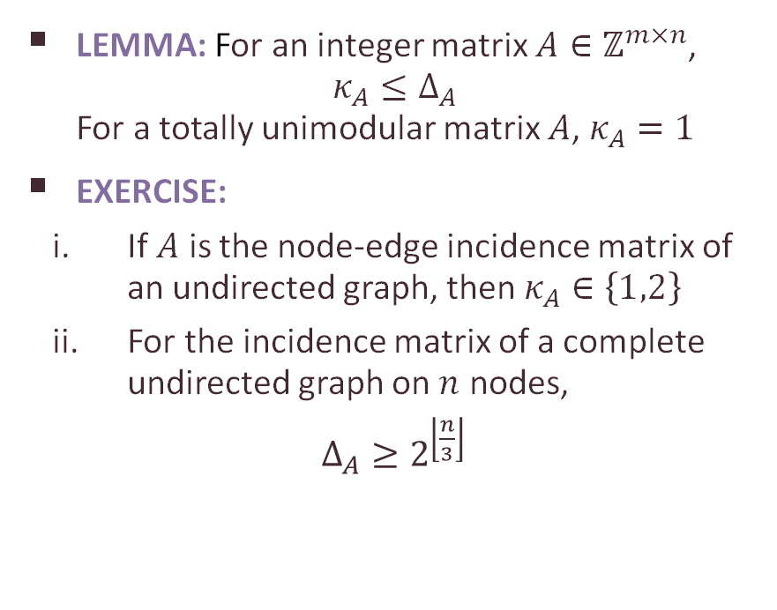
Properties of $κ_{A}$
LEMMA: For an integer matrix $A∈ℤ^{m×n}$, $κ_{A}≤Δ_{A}$ For a totally unimodular matrix $A$, $κ_{A}=1$
EXERCISE:
If $A$ is the node-edge incidence matrix of an undirected graph, then $κ_{A}∈\left\{1,2\right\}$
For the incidence matrix of a complete undirected graph on $n$ nodes,
$Δ_{A}≥2^{\left\lfloor \frac{n}{3}\right\rfloor }$

Slide 28
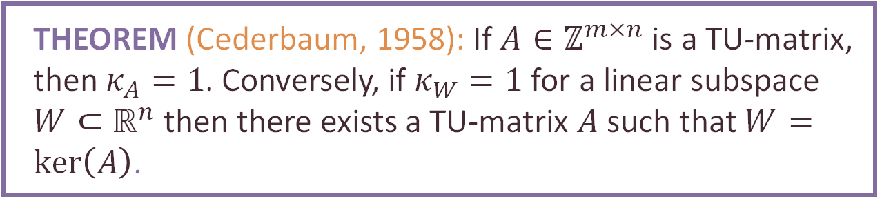
Circuit imbalance and TU matrices
THEOREM (Cederbaum, 1958): If $A∈ℤ^{m×n}$is a TU-matrix, then $κ_{A}=1$. Conversely, if $κ_{W}=1$ for a linear subspace $W⊂ℝ^{n}$ then there exists a TU-matrix $A$ such that $W=\ker\left(A\right)$.
PROOF (Ekbatani & Natura):

Slide 29
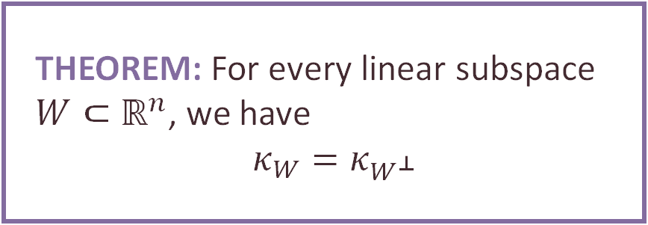
Duality of circuit imbalances
THEOREM: For every linear subspace $W⊂ℝ^{n}$, we have $$κ_{W}=κ_{W^{⊥}}$$

Slide 30
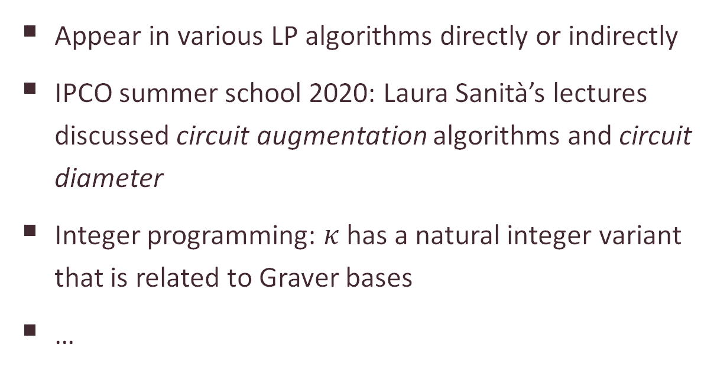
Circuits in optimization
Appear in various LP algorithms directly or indirectly
IPCO summer school 2020: Laura Sanità’s lectures discussed circuit augmentation algorithms and circuit diameter
Integer programming: $κ$has a natural integer variant that is related to Graver bases
…

Slide 31
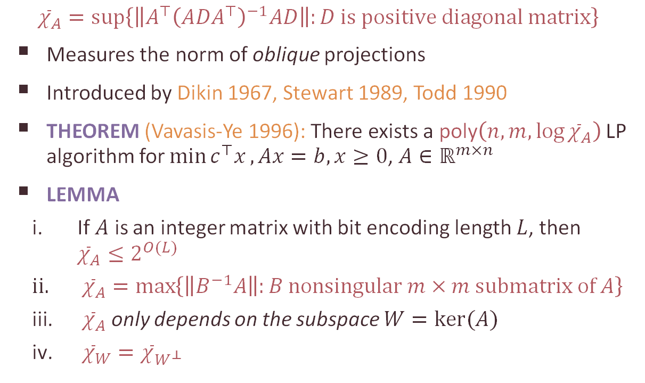

The condition number ${\overline{χ}}_{A}$
$${\overline{χ}}_{A}=sup\left\{\left\|A^{⊤}{\left(ADA^{⊤}\right)}^{−1}AD\right\|:D is positive diagonal matrix\right\}$$
Measures the norm of oblique projections
Introduced by Dikin 1967, Stewart 1989, Todd 1990
THEOREM (Vavasis-Ye 1996): There exists a poly$\left(n,m,\log{{\overline{χ}}_{A}}\right)$ LP algorithm for $\min{c^{⊤}x}, Ax=b,x≥0$, $A∈ℝ^{m×n}$
LEMMA
If $A$ is an integer matrix with bit encoding length $L$, then ${\overline{χ}}_{A}≤2^{O(L)}$
${\overline{χ}}_{A}=\max\left\{\left\|B^{−1}A\right\|:B nonsingular m×m submatrix of A\right\}$
${\overline{χ}}_{A}$ only depends on the subspace $W=ker⁡(A)$
${\overline{χ}}_{W}={\overline{χ}}_{W^{⊥}}$

Slide 32
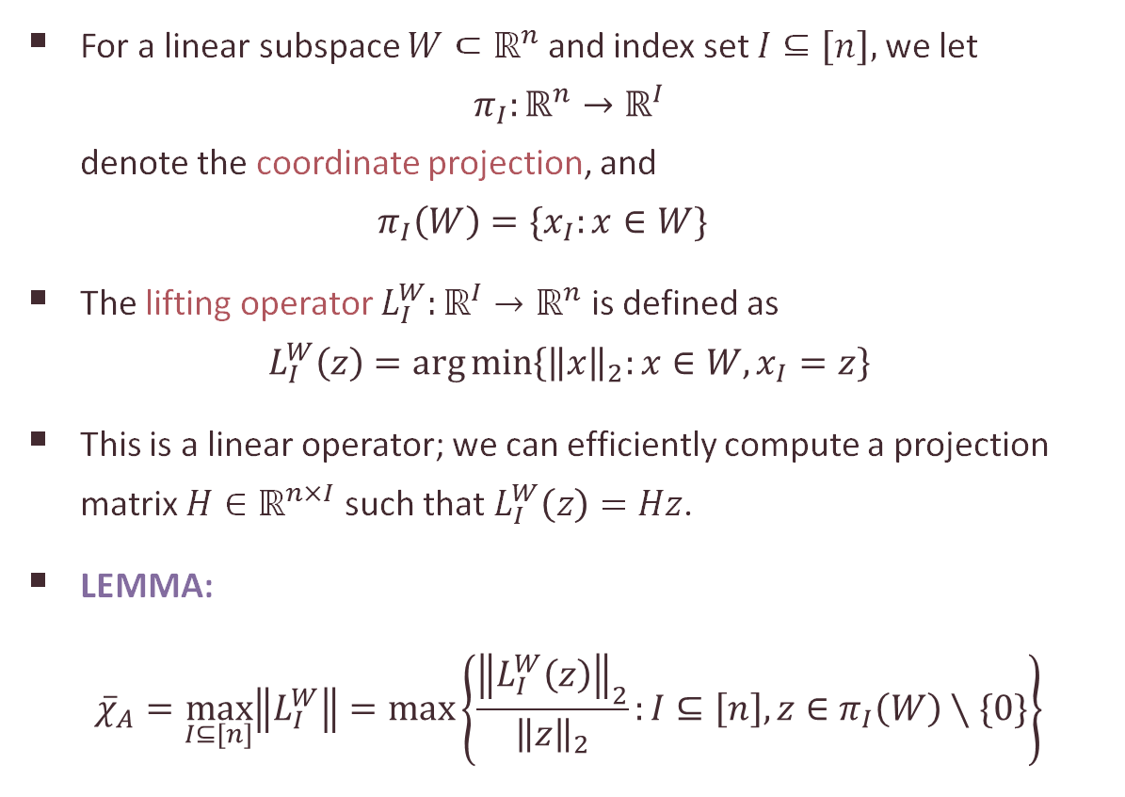
The lifting operator
For a linear subspace $W⊂ℝ^{n}$ and index set $I⊆\left[n\right],$ we let $π_{I}:ℝ^{n}→ℝ^{I}$ denote the coordinate projection, and $π_{I}\left(W\right)=\{x_{I}:x∈W\}$
The lifting operator $L_{I}^{W}:ℝ^{I}→ℝ^{n}$ is defined as $L_{I}^{W}\left(z\right)=\arg{\min\left\{{\left\|x\right\|}_{2}:x∈W, x_{I}=z\right\}}$
This is a linear operator; we can efficiently compute a projection matrix $H∈ℝ^{n×I}$ such that $L_{I}^{W}\left(z\right)=Hz$.
LEMMA: ${\overline{χ}}_{A}=\max_{I⊆[n]}\left\|L_{I}^{W}\right\|=\max\left\{\frac{{\left\|L_{I}^{W}\left(z\right)\right\|}_{2}}{{\left\|z\right\|}_{2}}:I⊆\left[n\right], z∈π_{I}\left(W\right)∖\{0\}\right\}$

Slide 33
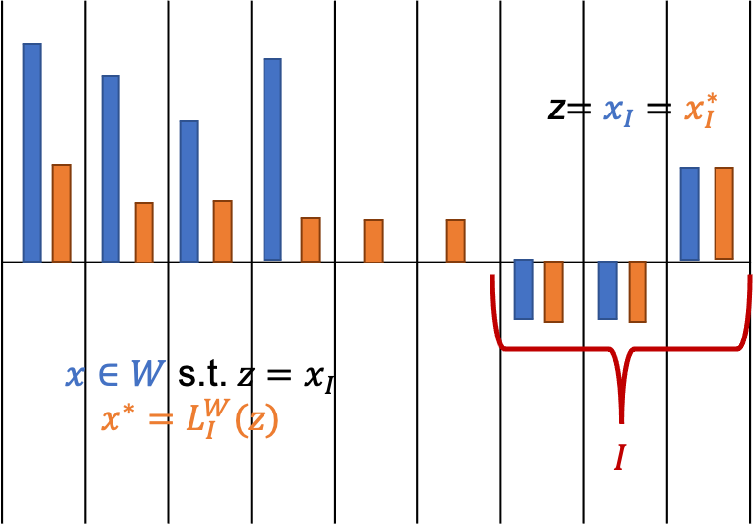
The lifting operator
$$L_{I}^{W}\left(z\right)=\arg{\min\left\{{\left\|x\right\|}_{2}:x∈W, x_{I}=z\right\}}$$

Slide 34
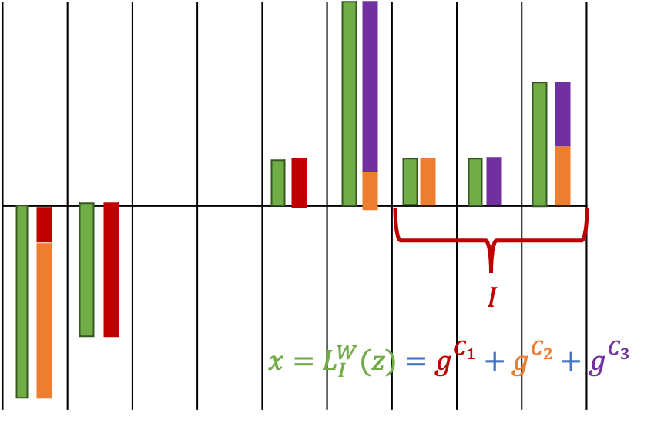
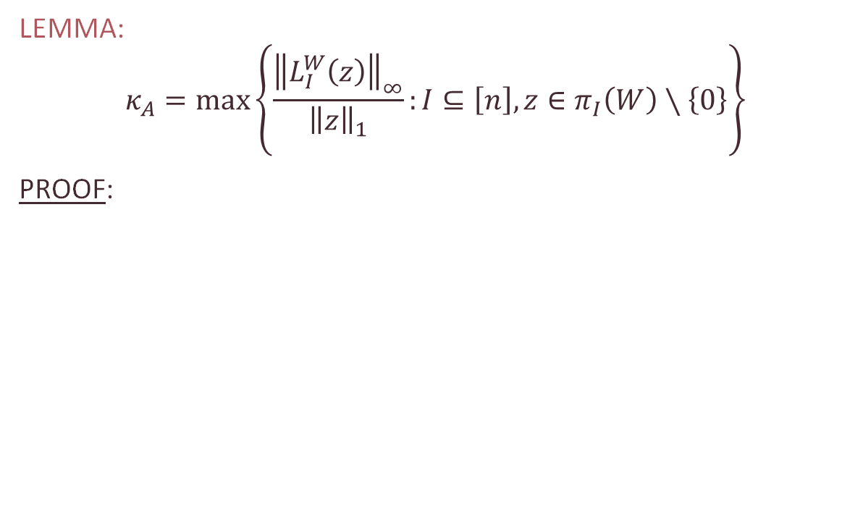
The lifting operator
LEMMA: $$κ_{A}=\max\left\{\frac{{\left\|L_{I}^{W}\left(z\right)\right\|}_{∞}}{{\left\|z\right\|}_{1}}:I⊆\left[n\right], z∈π_{I}\left(W\right)∖\left\{0\right\}\right\}$$
PROOF:

Slide 35
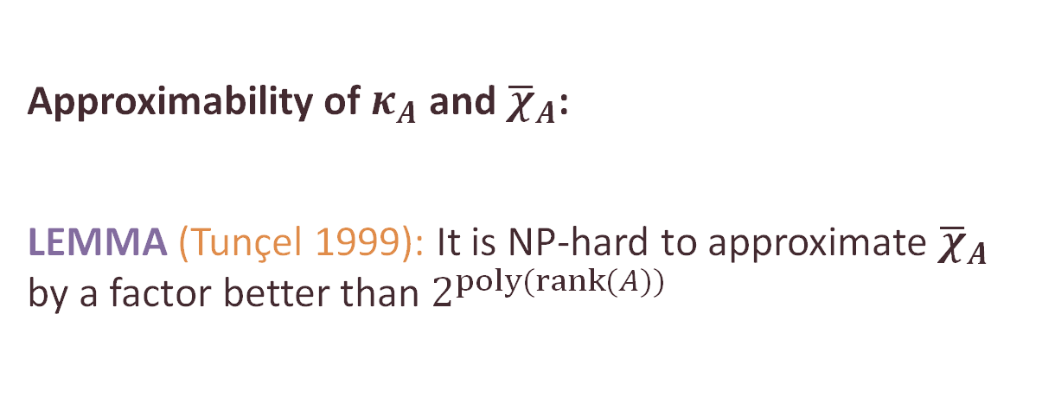


The condition numbers $κ_{A}$ and ${\overline{χ}}_{A}$
THEOREM: For every matrix $A∈ℝ^{m×n}$, $n≥2$
$\sqrt{1+κ_{A}^{2}}≤{\overline{χ}}_{A}≤nκ_{A}$
Approximability of $κ_{A}$ and ${\overline{χ}}_{A}$:
LEMMA (Tunçel 1999): It is NP-hard to approximate ${\overline{χ}}_{A}$ by a factor better than $2^{poly(rank(A))}$

Slide 36

Recap from Lecture 1
Overall goal: solving LPs exactly and “as strongly polynomially as possible”
One can reduce the dependence to the constraint matrix only:
Tardos ’86: poly$\left(n,m,\log{Δ_{A}}\right)$ black box LP algorithm
Vavasis-Ye ’96 Layered-least-squares Interior Point Method poly$\left(n,m,\log{{\overline{χ}}_{A}}\right)$
The crucial parameter of the constraint matrix is the circuit imbalance measure, a nice geometric parameter associated with the subspace $ker⁡(A)$
Updated slides available at https://personal.lse.ac.uk/veghl/ipco

Slide 37

Recap from Lecture 1
Tardos’s algorithm for min. cost generalized flows: circuits, proximity, and variable fixing
Circuit imbalance measure: matrix $A∈ℝ^{m×n}$ circuit: a set $C⊆[n]$ if $\left\{a_{i}:i∈C\right\}$ is a linearly dependent set minimal for containment. $∃g^{C}∈ℝ^{C}$ unique up to a scalar multiplication: $\sum_{i∈C}{g_{i}^{C}a_{i}=0}$
The circuit imbalance measure is defined as $κ_{A}=\max\left\{\frac{\left|g_{j}^{C}\right|}{\left|g_{i}^{C}\right|}:C∈𝒞_{A}, i,j∈C\right\}$
Properties: TU$⇒κ_{A}=1$; and $κ_{A}$ can be used to bound the lifting cost
5
2.4
-3
-1

Slide 38
Outline of the lectures
Tardos’s algorithm for min-cost flows
The circuit imbalance measure $κ_{A}$ and the condition measure ${\overline{χ}}_{A}$
Solving LPs: from approximate to exact
Optimizing circuit imbalances
Interior point methods: basic concepts
Layered-least-squares interior point methods

Slide 39


Part 3 Solving LPs: from approximate to exact

Slide 40


Fast approximate LP algorithms
$$\min{c^{⊤}x}$$
$$Ax=b$$
$$x≥0$$
$ε$-approximate solution:
Approximately feasible: $\left\|Ax−b\right\|≤ε({\left\|A\right\|}_{F}R+\left\|b\right\|$)
Approximately optimal: $c^{⊤}x≤OPT+ε \left\|c\right\| R$
Finding an approximate solution with $\log\left(\frac{1}{ε}\right)$ running time dependence implies a weakly polynomial exact algorithm.

Slide 41

Fast approximate LP algorithms
$$\min{c^{⊤}x} Ax=b x≥0$$
$n$ variables, $m$ equality constraints, Randomized vs. Deterministic
Significant recent progress:
R $O\left(\left(nnz\left(A\right)+m^{2}\right)\sqrt{m}\log^{O\left(1\right)}\left(n\right)\log\left(\frac{n}{ε}\right)\right)$Lee–Sidford ’13–’19
R $O\left(n^{ω}\log^{O\left(1\right)}\left(n\right)\log\left(\frac{n}{ε}\right)\right)$Cohen, Lee, Song ’19
D$O\left(n^{ω}\log^{2}\left(n\right)\log\left(\frac{n}{ε}\right)\right)$van den Brand ’20
R $O\left(\left(mn+m^{3}\right)\log^{O\left(1\right)}\left(n\right)\log\left(\frac{n}{ε}\right)\right)$van den Brand, Lee, Sidford, Song ’20
R $O\left(\left(mn+m^{2.5}\right)\log^{O\left(1\right)}\left(n\right)\log\left(\frac{n}{ε}\right)\right)$ van den Brand, Lee, Liu, Saranurak, Sidford, Song, Wang ’21
Some important techniques:
weighted and stochastic central paths
fast approximate linear algebra
efficient data structures

Slide 42



Fast exact LP algorithms with $κ_{A}$ dependence
$$\min{c^{⊤}x}$$
$$Ax=b$$
$$x≥0$$
$n$ variables, $m$ equality constraints
THEOREM (Dadush, Natura, V. ‘20) There exists a poly$(n,m,\log{κ_{A}) }$algorithm for solving LP exactly.
Feasibility: m calls to an approximate solver
Optimization: mn calls to an approximate solver
with $ε=1/(poly\left(n,κ_{A}\right))$. Using van den Brand ’20, this gives a deterministic exact $O\left(mn^{ω+1}\log^{2}\left(n\right)\log{{(κ}_{A}+n)}​\right)$ time LP optimization algorithm
Generalization of Tardos ’86 for real constraint matrices and with directly working with approximate solvers.
Main difference: arguments in Tardos ’86 heavily rely on integrality assumptions

Slide 43





Hoffman’s proximity theorem
Polyhedron $P=\left\{x∈ℝ^{n}:Ax≤b\right\}$, point $x_{0}∉P,$ norms ${\left\|.\right\|}_{α}$, ${\left\|.\right\|}_{β}$
THEOREM (Hoffman, 1952): There exists a constant $H_{α,β}(A)$ such that
$$∃x∈P: {\left\|x−x_{0}\right\|}_{α}≤H_{α,β}(A){\left\|{\left(Ax_{0}−b\right)}^{+}\right\|}_{β}$$
$$P$$
$$x$$
Alan J. Hoffman 1924-2021
$$x_{0}$$

Slide 44





LP in subspace form
Matrix form: $A∈ℝ^{m×n}, b∈ℝ^{m}, c∈ℝ^{n}$
Subspace form: $W=\ker\left(A\right), d∈ℝ^{n}$ s.t. $Ad=b$
$$\min{c^{⊤}x}$$
$$Ax=b$$
$$x≥0$$
$$\max{b^{⊤}y}$$
$$A^{⊤}y+s=c$$
$$s≥0$$
$$\min{c^{⊤}x}$$
$$x∈W+d \\ x≥0$$
$$\max{ d^{⊤}(c−s)}$$
$$s∈W^{⊥}+c$$
$$s≥0$$

Slide 45




Proximity theorem with $κ_{A}$
THEOREM: For $A∈ℝ^{m×n}, d∈ℝ^{n}$, consider the system
$$Ax=Ad, x≥0.$$ If feasible, then there exists a feasible solution $x$ such that $${\left\|x−d\right\|}_{∞}≤κ_{A}{\left\|d^{−}\right\|}_{1}$$
PROOF:

Slide 46



Linear feasibility algorithm
Linear feasibility problem
$$Ax=Ad, x≥0.$$
Recursive algorithm using a stronger problem formulation:
$$Ax=Ad, x≥0.$$
$${\left\|x−d\right\|}_{∞}≤C′κ_{A}^{2}{\left\|d^{−}\right\|}_{1}$$
Variable fixing: conclude $x_{i}>0$ and project out $x_{i}$
Black box oracle for $ε=1/(poly\left(n,κ_{A}\right))$
$$Ax=Ad \\ {\left\|x−d\right\|}_{∞}≤Cκ_{A}{\left\|d^{−}\right\|}_{1}$$
$${\left\|x^{−}\right\|}_{∞}≤ε{\left\|d^{−}\right\|}_{1}$$
proximity
error

Slide 47


The lifting operator
$$L_{I}^{W}\left(z\right)=\arg{\min\left\{{\left\|x\right\|}_{2}:x∈W, x_{I}=z\right\}}$$
$$W=ker⁡(A)$$
LEMMA:$κ_{A}=\max\left\{\frac{{\left\|L_{I}^{W}\left(z\right)\right\|}_{∞}}{{\left\|z\right\|}_{1}}:I⊆\left[n\right], z∈π_{I}\left(W\right)∖\{0\}\right\}$
For every $z∈π_{I}(W)$, $x=L_{I}^{W}\left(z\right)∈W=ker⁡(A)$ s.t. $$x_{I}=z, and {\left\|x\right\|}_{∞}≤κ_{A}{\left\|z\right\|}_{1}$$

Slide 48







The linear feasibility algorithm
Problem $ℱ(ker⁡(A),d)$
Call the black box solver to find a solution $z$ for $ε=1/{\left(κ_{A}n\right)}^{4}$
Set $J=\{i∈\left[n\right]:z_{i}<κ_{A}{\left\|d^{−}\right\|}_{1}$}; assume $J≠[n]$.
Recursively obtain $\tilde{x}∈ℝ_{+}^{J}$ from $ℱ(π_{J}(ker⁡(A)),z_{J})$
Return $x=z+L_{J}^{W}(\tilde{x}−z_{J})$
$$Ax=Ad$$
$${\left\|x−d\right\|}_{∞}≤C′κ_{A}^{2}{\left\|d^{−}\right\|}_{1}$$
$$x≥0$$
$$Az=Ad \\ {\left\|z−d\right\|}_{∞}≤Cκ_{A}{\left\|d^{−}\right\|}_{1}$$
$${\left\|z^{−}\right\|}_{∞}≤ε{\left\|d^{−}\right\|}_{1}$$
$$κ_{A}{\left\|d^{−}\right\|}_{1}$$
J
$$W=ker⁡(A)$$

Slide 49







Call the black box solver to find a solution $z$ for $ε=1/{\left(κ_{A}n\right)}^{4}$
Set $J=\{i∈\left[n\right]:z_{i}<κ_{A}{\left\|d^{−}\right\|}_{1}$}; assume $J≠[n]$.
Recursively obtain $\tilde{x}∈ℝ_{+}^{J}$ from $ℱ(π_{J}(ker⁡(A)),z_{J})$
Return $x=z+L_{J}^{W}(\tilde{x}−z_{J})$
Problem $ℱ(ker⁡(A),d)$
$$Az=Ad$$
$${\left\|x−d\right\|}_{∞}≤C′κ_{A}^{2}{\left\|d^{−}\right\|}_{1}$$
$$x≥0$$
$$Az=Ad \\ {\left\|z−d\right\|}_{∞}≤Cκ_{A}{\left\|d^{−}\right\|}_{1}$$
$${\left\|z^{−}\right\|}_{∞}≤ε{\left\|d^{−}\right\|}_{1}$$
$$κ_{W}{\left\|d^{−}\right\|}_{1}$$
$$W=ker⁡(A)$$
J

Slide 50

The linear feasibility algorithm
$J=\{i∈\left[n\right]:z_{i}<κ_{A}{\left\|d^{−}\right\|}_{1}$};
If $J=[n]$, then we replace $d$ by its projection to $W^{⊥}=im\left(A^{⊤}\right)$
Bound $n$on the number of recursive calls; can be decreased to $m$
$O(mn^{ω+o\left(1\right)}log⁡(κ_{W}​+n))$feasibility algorithm using van den Brand '20.

Slide 51

Certification
In case of infeasibility we return an exact Farkas certificate
$κ_{A}$ is hard to approximate within $2^{O\left(n\right)}$ Tunçel 1999
We use an estimate $M$ in the algorithm
The algorithm may fail if ${\left\|L_{J}^{W}(\tilde{x}−z_{J})\right\|}_{∞}>M{\left\|\tilde{x}−z_{J}\right\|}_{1}$
In this case, we restart with $\max\left\{M^{2}, \frac{{\left\|L_{J}^{W}(\tilde{x}−z_{J})\right\|}_{∞}}{{\left\|\tilde{x}−z_{J}\right\|}_{1}}\right\}$
Our estimate never overshoots $κ_{A}$ by much, but can be significantly better.

Slide 52



Proximity for optimization
$$\min{c^{⊤}x}$$
$$Ax=Ad \\ x≥0$$
$$\max{ b^{⊤}y}$$
$$A^{⊤}y+s=c \\ s≥0$$
THEOREM: Let $A^{⊤}y+s=c, s≥0$ be a feasible dual solution, and assume the primal is also feasible. Then there exists a primal optimal $Ax^{∗}=Ad, x^{∗}≥0$ such that
$${\left\|x^{∗}−d\right\|}_{∞}≤κ_{A}\left({\left\|d^{−}\right\|}_{1}+{\left\|d_{supp\left(s\right)}\right\|}_{1}\right).$$

Slide 53

Optimization algorithm
$$\min{c^{⊤}x}$$
$$Ax=Ad \\ x≥0$$
$$\max{ b^{⊤}y}$$
$$A^{⊤}y+s=c \\ s≥0$$
$nm$ calls to the black box solver
$≤n$Outer Loops, each comprising $≤m$ Inner Loops
Each Outer Loop finds $\tilde{d}$ with $\left\|d−\tilde{d}\right\|$"small", and $(x,s)$ primal and dual optimal solutions to $\min{c^{⊤}x} s.t. Ax=A\tilde{d}, d≥0$
Using proximity, we can use this to conclude $x_{I}>0$ for a certain variable set $I⊆n$ and recurse.

Slide 54
Outline of the lectures
Tardos’s algorithm for min-cost flows
The circuit imbalance measure $κ_{A}$ and the condition measure ${\overline{χ}}_{A}$
Solving LPs: from approximate to exact
Optimizing circuit imbalances
Interior point methods: basic concepts
Layered-least-squares interior point methods

Slide 55

Part 4 Optimizing circuit imbalances

Slide 56






Diagonal rescaling of LP
$$\min{c^{⊤}x}$$
$$Ax=b$$
$$x≥0$$
$$\max{b^{⊤}y}$$
$$A^{⊤}y+s=c$$
$$s≥0$$
Positive diagonal matrix $D∈ℝ^{n×n}$
$$\min{{ (Dc)}^{⊤}x′}$$
$$ADx′=b$$
$$x′≥0$$
$$\max{b^{⊤}y′}$$
$${(AD)}^{⊤}y′+s′=Dc$$
$$s′≥0$$
Mapping between solutions: $$x^{′}=D^{−1}x, y^{′}=y, s^{′}=Ds$$

Slide 57




Diagonal rescaling of LP
Positive diagonal matrix $D∈ℝ^{n×n}$
$$\min{{ (Dc)}^{⊤}x′}$$
$$ADx′=b$$
$$x′≥0$$
$$\max{b^{⊤}y′}$$
$${(AD)}^{⊤}y′+s′=Dc$$
$$s′≥0$$
Mapping between solutions: $$x^{′}=D^{−1}x, y^{′}=y, s^{′}=Ds$$
Natural symmetry of LPs and many LP algorithms.
The Central Path is invariant under diagonal scaling.
Most “standard” interior point methods are invariant.

Slide 58

Dependence on the constraint matrix only
$$\min{c^{⊤}x,} Ax=b x≥0$$
Algorithms with running time dependent only on $A$, but not on $b$ and $c$.
Combinatorial LP’s: integer matrix $A∈ℤ^{m×n}$.
$$Δ_{A}=\max{\{|\det\left(B\right)|:B submatrix}of A\}$$
Tardos ’86: poly$\left(n,m,\log{Δ_{A}}\right)$ LP algorithm
Layered-least-squares (LLS) Interior Point Method Vavasis-Ye ’96: poly$\left(n,m,\log{{\overline{χ}}_{A}}\right)$ LP algorithm in the real model of computation ${\overline{χ}}_{A}$: condition number
Dadush-Huiberts-Natura-V ’20: poly$\left(n,m,\log{{\overline{χ}}_{A}^{∗}}\right)$ ${\overline{χ}}_{A}^{∗}$: optimized version of ${\overline{χ}}_{A}$
❌
❌
✔️

Slide 59




Optimizing$κ_{A}^{}$ and ${\overline{χ}}_{A}^{}$ by rescaling
$𝒟=set of n×n$ positive diagonal matrices
$$κ_{A}^{∗}=\inf{\{κ_{AD}:D∈}𝒟\}$$
$${\overline{χ}}_{A}^{∗}=\inf{\{{\overline{χ}}_{AD}:D∈}𝒟\}$$
A scaling invariant algorithm with ${\overline{χ}}_{A}$ dependence automatically yields ${\overline{χ}}_{A}^{∗}$ dependence.
Recall $\sqrt{1+κ_{A}^{2}}≤{\overline{χ}}_{A}≤nκ_{A}.$
THEOREM (Dadush-Huiberts-Natura-V ’20): Given $A∈ℝ^{m×n}$, in $O(n^{2}m^{2}+n^{3})$ time, one can
approximate the value $κ_{A}$ within a factor ${\left(κ_{A}^{∗}\right)}^{2}$, and
compute a rescaling $D∈𝒟$ satisfying $κ_{AD}≤{\left(κ_{A}^{∗}\right)}^{3}$.
THEOREM (Tunçel 1999): It is NP-hard to approximate ${\overline{χ}}_{A}$ (and thus $κ_{A})$ by a factor better than $2^{poly(rank(A))}$

Slide 60


Approximating$κ_{A}^{∗}$
$𝒟=set of n×n$ positive diagonal matrices
$$κ_{A}^{∗}=\inf{\{κ_{AD}:D∈}𝒟\}$$
EXAMPLE: Let $\ker\left(A\right)=span(\left(0,1,1,M\right), (1,0,M,1)$ )

Slide 61

Pairwise circuit imbalances
For a circuit $C$, there exists a vector $g^{C}∈ℝ^{C}$ unique up to a scalar multiplier such that $\sum_{i∈C}{g_{i}^{C}a_{i}=0}$
$𝒞_{A}$ : set of all circuits.
For any $i,j∈[n]$, $κ_{ij}=\max\left\{\frac{\left|g_{j}^{C}\right|}{\left|g_{i}^{C}\right|}:C∈𝒞_{A}, s.t.i,j∈C\right\}$
The circuit imbalance measure is $κ_{A}=\max_{i,j∈[n]}{κ_{ij}}$

Slide 62

Cycles are invariant under scaling
LEMMA For any directed cycle $H$ on $\{1,2,…,n\}$ $${\left(κ_{A}^{∗}\right)}^{|H|}≥\prod_{\left(i,j\right)∈H}{κ_{ij}}$$

Slide 63

Circuit imbalance min-max formula
THEOREM (Dadush-Huiberts-Natura-V ’20): $$κ_{A}^{∗}=\max\left\{{\left(\prod_{\left(i,j\right)∈H}{κ_{ij}}\right)}^{1/|H|}: H \text{directed} \text{cycle} \text{on} \{1,2,…,n\} \right\}$$
PROOF:

Slide 64

Circuit imbalance min-max formula
THEOREM (Dadush-Huiberts-Natura-V ’20): $$κ_{A}^{∗}=\max\left\{{\left(\prod_{\left(i,j\right)∈H}{κ_{ij}}\right)}^{1/|H|}: H \text{directed} \text{cycle} \text{on} \{1,2,…,n\} \right\}$$
BUT: Computing the $κ_{ij}$ values is NP-complete…
LEMMA: For any circuit $C∈𝒞_{A}$s.t. $i,j∈C$,
$$\frac{\left|g_{j}^{C}\right|}{\left|g_{i}^{C}\right|}≥\frac{κ_{ij}}{{\left(κ_{W}^{∗}\right)}^{2}}$$

Slide 65
Outline of the lectures
Tardos’s algorithm for min-cost flows
The circuit imbalance measure $κ_{A}$ and the condition measure ${\overline{χ}}_{A}$
Solving LPs: from approximate to exact
Optimizing circuit imbalances
Interior point methods: basic concepts
Layered-least-squares interior point methods

Slide 66

Part 5 Interior point methods: basic concepts

Slide 67



Primal and dual LP
$A∈ℝ^{m×n}, c,d∈ℝ^{m}$
Complementary slackness: Primal and dual solutions $(x,s)$ are optimal if $x^{⊤}s=0$: for each $i∈[n]$, either $x_{i}=0$ or $s_{i}=0.$
Optimality gap: $c^{⊤}x−b^{⊤}y=x^{⊤}s.$
$$\min{c^{⊤}x}$$
$$Ax=Ad$$
$$x≥0$$
$$\max{b^{⊤}y}$$
$$A^{⊤}y+s=c$$
$$s≥0$$

Slide 68

The central path
For each $μ>0$, there exists a unique solution $w(μ)=(x(μ),y(μ),s(μ))$such that
$$x{\left(μ\right)}_{i}s{\left(μ\right)}_{i}=μ ∀i∈\left[n\right]$$ the central path element for $μ$.
The central path is the algebraic curve formed by$\{w(μ):μ>0\}$
For $μ→0$, the central path converges to an optimal solution $w^{∗}=(x^{∗},y^{∗},s^{∗})$.
The optimality gap is $s{\left(μ\right)}^{⊤}x(μ)=nμ.$
Interior point algorithms: walk down along the central path with $μ$ decreasing geometrically.

Slide 69

The Mizuno-Todd-Ye Predictor-Corrector Algorithm
Start from point $w_{0}=(x_{0},y_{0},s_{0})$'near' the central path at some $μ_{0}>0$.
Alternate between
Predictor steps: 'shoot down' the central path, decreasing $μ$ by a factor at least $1−β/n​.$ May move slightly 'farther' from the central path.
Corrector steps: do not change parameter $μ$, but move back 'closer' to the central path.
Within $O(n​)$ iterations, $μ$ decreases by a factor 2.

Slide 70


The predictor step
Step direction $Δw=(Δx,Δy,Δs)$
Pick the largest $α∈[0,1]$ such that $w′$ is still “close enough” to the central path $w^{′}=w+αΔw=\left(x+αΔx,y+αΔy,s+αΔs\right)$
Long step: $|Δx_{i}Δs_{i}|$small for every $i∈[n]$
New optimality gap is $\left(1−α\right)μ$.
$$AΔx=0 \\ A^{⊤}Δy+Δs=0 \\ { s}_{i}Δx_{i}+x_{i}Δs_{i}=−x_{i}s_{i} ∀i∈[n]$$

Slide 71


The predictor step least squares view
$$AΔx=0 \\ A^{⊤}Δy+Δs=0 \\ { s}_{i}Δx_{i}+x_{i}Δs_{i}=−x_{i}s_{i} ∀i∈[n]$$
Assume the current point $w=(x,y,s)$ is on the central path. The steps can be found as minimum norm projections in the $(1/x)$ and $(1/s)$ rescaled norms $Δx=\arg{\min{\sum_{i=1}^{n}{{\left(\frac{x_{i}+Δx_{i}}{x_{i}}\right)}^{2}}}} s.t. AΔx=0$
$$Δs=\arg{\min{{{\sum_{i=1}^{n}{\left(\frac{s_{i}+Δs_{i}}{s_{i}}\right)}}^{2}}^{}}} s.t. A^{⊤}Δy+Δs=0$$

Slide 72
Some recent progress on interior point methods
Tremendous recent progress on fast approximate variants LS’14–’19, CLS’19,vdB’20,vdBLSS’20,vdBLLSSSW’21
Fast approximate algorithms for combinatorial problems flows, matching and MDPs: DS’08, M’13, M’16, CMSV’17, AMV’20, vdBLNPTSSW’20, vdBLLSSSW’21

Slide 73
Outline of the lectures
Tardos’s algorithm for min-cost flows
The circuit imbalance measure $κ_{A}$ and the condition measure ${\overline{χ}}_{A}$
Solving LPs: from approximate to exact
Optimizing circuit imbalances
Interior point methods: basic concepts
Layered-least-squares interior point methods

Slide 74

Part 6 Layered-least-squares interior point methods

Slide 75

Layered-least-squares (LLS) Interior Point Methods: Dependence on the constraint matrix only
$${\overline{χ}}_{A}^{∗}=\inf{\{{\overline{χ}}_{AD}:D∈}𝒟\}$$
Vavasis-Ye ’96: O$\left(n^{3.5}\log{({\overline{χ}}_{A}+n} )\right)$ iterations
Monteiro-Tsuchiya ’03 O$\left(n^{3.5}\log{({\overline{χ}}_{A}^{∗}+n} )+n^{2}\log{\log{1/ε}}\right)$ iterations
Lan-Monteiro-Tsuchiya ‘09 O$\left(n^{3.5}\log{({\overline{χ}}_{A}^{∗}+n} )\right)$ iterations, but the running time of the iterations depends on b and c
Dadush-Huiberts-Natura-V ’20: scaling invariant LLS method with O$\left(n^{2.5}\log{(n)}\log{({\overline{χ}}_{A}^{∗}+n} )\right)$ iterations

Slide 76

Near monotonicity of the central path
IPM learns gradually improved upper bounds on the optimal solution.
LEMMA For $w=(x,y,s)$ on the central path, and for any solution $w^{′}=(x^{′},y^{′},s^{′})$ s.t. ${\left(x^{′}\right)}^{⊤}s^{′}≤x^{⊤}s$, we have
$$\sum_{i=1}^{n}{\frac{x_{i}^{′}}{x_{i}}+\frac{s_{i}^{′}}{s_{i}}}≤2n$$

Slide 77


Variable fixing…—or not?
LEMMA After every iteration, there exists variables $x_{i}$ and $s_{j}$ such that
$$\frac{1}{O\left(n\right)}≤\frac{x_{i}}{x_{i}^{∗}},\frac{s_{j}}{s_{j}^{∗}}≤O\left(n\right)$$ For the optimal $\left(x^{∗},y^{∗},s^{∗}\right).$Thus, $x_{i}$ and $s_{j}$ have “converged” to their final values.
PROOF: Can be shown using the form of the predictor step: $Δx=\arg{\min{\sum_{i=1}^{n}{{\left(\frac{x_{i}+Δx_{i}}{x_{i}}\right)}^{2}}}} s.t. AΔx=0$
$$Δs=\arg{\min{{{\sum_{i=1}^{n}{\left(\frac{s_{i}+Δs_{i}}{s_{i}}\right)}}^{2}}^{}}} s.t. A^{⊤}Δy+Δs=0$$
and bounds on the stepsize.

Slide 78

Variable fixing…—or not?
LEMMA After every iteration, there exists variables $x_{i}$ and $s_{j}$ such that
$$\frac{1}{O\left(n\right)}≤\frac{x_{i}}{x_{i}^{∗}},\frac{s_{j}}{s_{j}^{∗}}≤O\left(n\right)$$ For the optimal $\left(x^{∗},y^{∗},s^{∗}\right).$Thus, $x_{i}$ and $s_{j}$ have “converged” to their final values.
We cannot identify these indices, just show their existence
🤔

Slide 79

Layered least squares methods
Instead of the standard predictor step, split the variables into layers.
Variables on different layers “behave almost like separate LPs”
Force new primal and dual variables that must have converged.

Slide 80



Recap: the lifting operator and $κ_{A}$
For a linear subspace $W⊂ℝ^{n}$ and index set $I⊆\left[n\right],$ we let $π_{I}:ℝ^{n}→ℝ^{I}$ denote the coordinate projection, and $π_{I}\left(W\right)=\{x_{I}:x∈W\}$
The lifting operator $L_{I}^{W}:ℝ^{I}→ℝ^{n}$ is defined as $L_{I}^{W}\left(z\right)=\arg{\min\left\{{\left\|x\right\|}_{2}:x∈W, x_{I}=z\right\}}$
LEMMA:$κ_{A}=\max\left\{\frac{{\left\|L_{I}^{W}\left(z\right)\right\|}_{∞}}{{\left\|z\right\|}_{1}}:I⊆\left[n\right], z∈π_{I}\left(W\right)∖\{0\}\right\}$
For every $z∈π_{I}(W)$, $x=L_{I}^{W}\left(z\right)∈W=ker⁡(A)$ s.t. $x_{I}=z, and {\left\|x\right\|}_{∞}≤κ_{A}{\left\|z\right\|}_{1}$
$$W=ker⁡(A)$$

Slide 81



Motivating the layering idea: final rounding step in standard IPM
$$\min{c^{⊤}x}$$
$$Ax=b$$
$$x≥0$$
$$\max{b^{⊤}y}$$
$$A^{⊤}y+s=c$$
s$≥0$
Limit optimal solution $\left(x^{∗},y^{∗},s^{∗}\right),$ and optimal partition $\left[n\right]=B∪N$ s.t. $B=supp\left(x^{∗}\right), N=supp\left(s^{∗}\right)$.
Given $(x,y,s)$ near central path with ‘small enough’ $μ=s^{⊤}x/n$ such that for every $i∈[n]$, either $x_{i}$or $s_{i}$very small.
Assume that we can correctly guess $B=\left\{i:x_{i}>M\sqrt{μ}\right\}, N=\{i:s_{i}>M\sqrt{μ}\}$

Slide 82

Assume we have a partition $B, N$, we have $i∈B: x_{i}>M\sqrt{μ}, s_{i}<\sqrt{μ}/M$ $i∈N:x_{i}<\sqrt{μ}/M, s_{i}>M\sqrt{μ}$
Goal: move to $\overline{x}=x+Δx, \overline{y}=y+Δy, \overline{s}=s+Δs$ s.t. $supp\left(\overline{x}\right)⊆B$, $supp\left(\overline{s}\right)⊆N$. Then, ${\overline{x}}^{⊤}\overline{s}=0$: optimal solution.
Choice: $Δx=−L_{N}^{W}\left(x_{N}\right), Δs=−L_{B}^{W}\left(s_{B}\right)$

Slide 83



Layered-least-squares step
Assume we have a partition $B, N$, with $$i∈B: x_{i}>M\sqrt{μ}, s_{i}<\sqrt{μ}/M \\ i∈N:x_{i}<\sqrt{μ}/M, s_{i}>M\sqrt{μ}$$
Vavasis-Ye LLS step with layers $(B,N)$:
$$Δx_{N}=\arg{\min{\sum_{i∈N}{{\left(\frac{x_{i}+Δx_{i}}{x_{i}}\right)}^{2}}}} \\ s.t. AΔx=0$$
$$Δx_{B}=\arg{\min{\sum_{i∈B}{{\left(\frac{x_{i}+Δx_{i}}{x_{i}}\right)}^{2}}}} \\ s.t. A\left(Δx_{B},Δx_{N}\right)=0$$
Standard primal predictor step:
$$Δx=\arg{\min{ \sum_{i=1}^{n}{{\left(\frac{x_{i}+Δx_{i}}{x_{i}}\right)}^{2}}}} \\ s.t. AΔx=0$$

Slide 84


Layered-least-squares step Vavasis-Ye ‘96
Order variables decreasingly as $x_{1}≥x_{2}≥…≥x_{n}$
Arrange variables into layers $(J_{1},J_{2},…,J_{t})$; start a new layer when $x_{i }>O\left(n^{c}\right) {\overline{χ}}_{A}x_{i+1 }$
Primal step direction by least squares problems from backwards, layer-by-layer
Lifting costs from lower layers low
Dual step in the opposite direction
Not scaling invariant!

Slide 85

Progress measure: crossover events Vavasis-Ye’96
DEFINITION: The variables $x_{i}$ and $x_{j}$ cross over between $μ$ and $μ^{′}$, $μ>μ^{′}$, if
$O\left(n^{c}\right){\left({\overline{χ}}_{A}\right)}^{n} x_{j}\left(μ\right)≥x_{i}\left(μ\right)$
$O\left(n^{c}\right){\left({\overline{χ}}_{A}\right)}^{n} x_{j}\left(μ′′\right)<x_{i}\left(μ′′\right)$ for any $μ^{′′}≤μ′$
LEMMA: In the Vavasis-Ye algorithm, a crossover event happens every $O(n^{1.5 }\log{({\overline{χ}}_{A}+n))}$ iterations, totalling to $O(n^{3.5 }\log{({\overline{χ}}_{A}+n))}$.

Slide 86



Scaling invariant layering DNHV’20
Instead of the ratios $x_{i}/x_{j}$, we consider the rescaled circuit imbalance measures $κ_{ij}x_{i}/x_{j}$
Layers: strongly connected components of the arcs $\left(i,j\right): \frac{κ_{ij}x_{i}}{x_{j}}>\frac{1}{poly\left(n\right)}$
The $κ_{ij}$ values are not known: increasingly improving estimates.

Slide 87

Scaling invariant crossover events Vavasis-Ye’96
DEFINITION: The variables $x_{i}$ and $x_{j}$ cross over between $μ$ and $μ^{′}$, $μ>μ^{′}$, if
$O\left(n^{c}\right){\left({\overline{χ}}_{A}\right)}^{n} x_{j}\left(μ\right)≥{κ_{ij}x}_{i}\left(μ\right)$
$O\left(n^{c}\right){\left({\overline{χ}}_{A}\right)}^{n} x_{j}\left(μ′′\right)<κ_{ij}x_{i}\left(μ′′\right)$ for any $μ^{′′}≤μ′$
Amortized analysis, resulting in improved $O(n^{2.5 }\log{(n)}\log{({\overline{χ}}_{A}+n))}$ iteration bound.

Slide 88

Limitation of IPMs
THEOREM (Allamigeon–Benchimol–Gaubert–Joswig ‘18): No standard path following method can be strongly polynomial.
Proof using tropical geometry: studies the tropical limit of a family of parametrized linear programs.

Slide 89
Future directions
Circuit imbalance measure: key parameter for strongly polynomial solvability.
LP classes with existence of strongly polynomial algorithms open:
LPs with 2 nonzeros per column in the constraint matrix, equivalently: min cost generalized flows
Undiscounted Markov Decision Processes
Extend the theory of circuit imbalances more generally, to convex programming and integer programming.
Thank you!

Slide 90

Postdoc position open
Application deadline: 5 June

